Slide 1
Distributed Supervisory Control

Slide 2





Control architectures
SUP
SUP1
SUP2
G
G1
G2
SUP1
SUP2
G

Slide 3

How to design distributed control
SUP
LOC1
LOC2
G1 G2
G1
G2

Slide 4
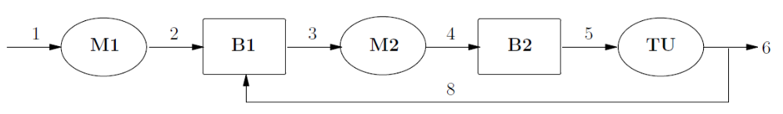
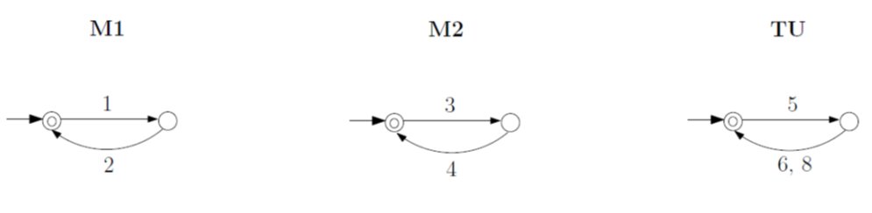
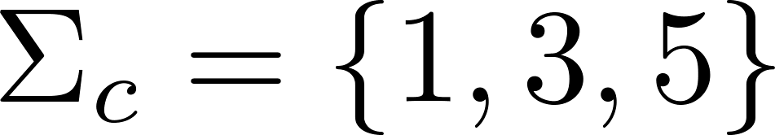
Transfer Line

Slide 5
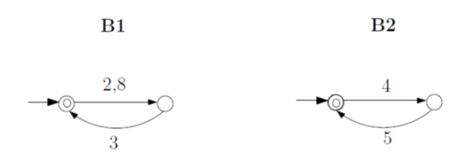
Transfer Line

Slide 6

Transfer Line

Slide 7
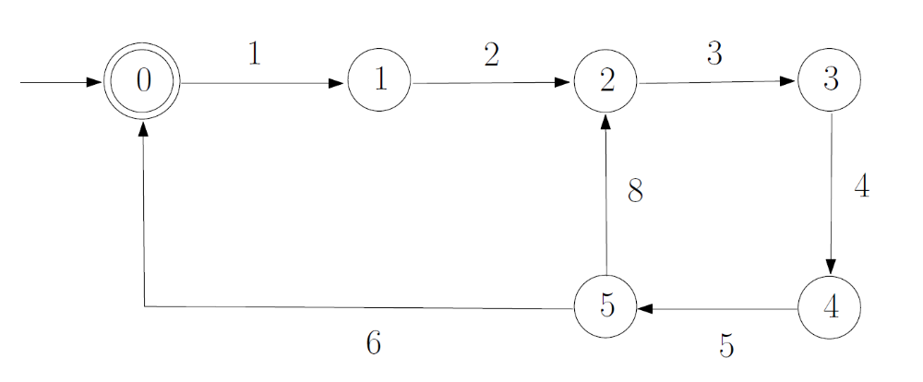

Transfer Line
3,5
3,5
1,5
1,5
1,3
1,3

Slide 8






Transfer Line
communication
1
3
5
1
3
5
Supervisor Localization

Slide 9

Control actions of event 1 (M1)
1
1
1
1

Slide 10

Control actions of event 3 (M2)
3
3
3
3

Slide 11

Control actions of event 5 (TU)
5
5
5
5

Slide 12
Transfer Line
communication
1
3
5
1
3
5
Key question (?)

Slide 13
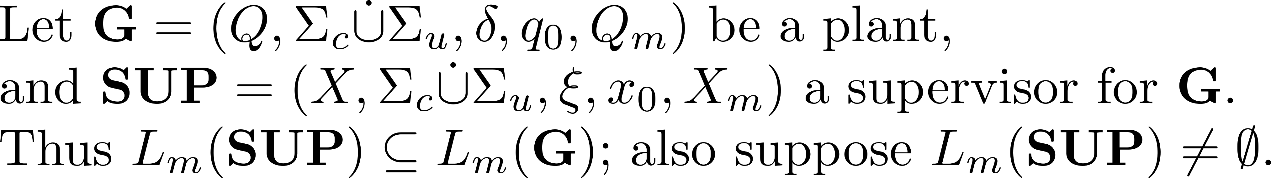
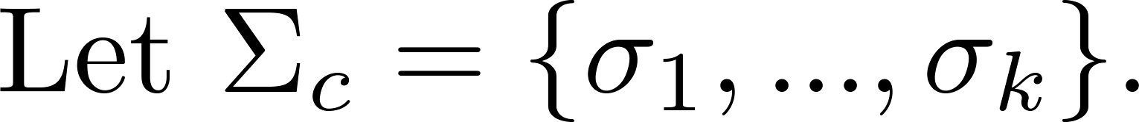
Localization problem

Slide 14
Localization procedure

Slide 15




Example
1
1
0
2
0
2
3
3

Slide 16

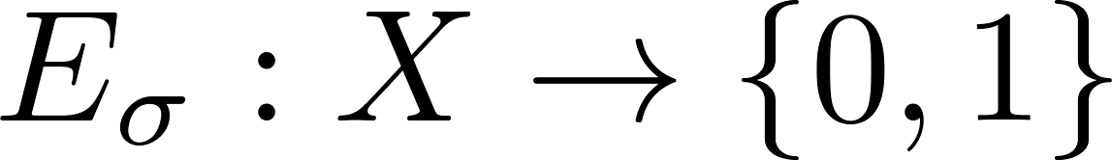


Control information

Slide 17





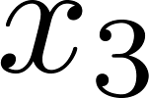
Example
1
1
0
2
0
2
3
3

Slide 18
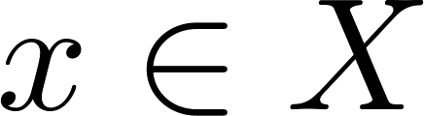



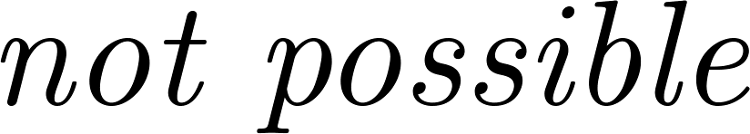
Note

Slide 19

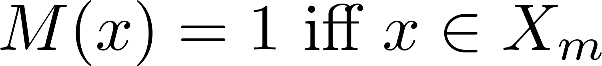

Marking information

Slide 20


Example
1
1
0
2
0
2
3
3

Slide 21
Note

