Slide 1
Decentralized Supervisory Control

Slide 2




Control architectures
G
SUP
G
SUP1
SUP2

Slide 3
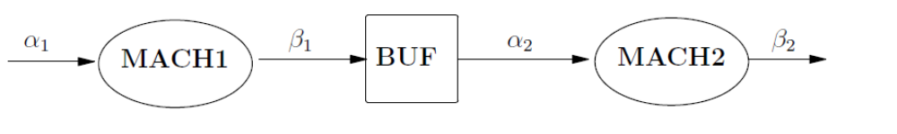

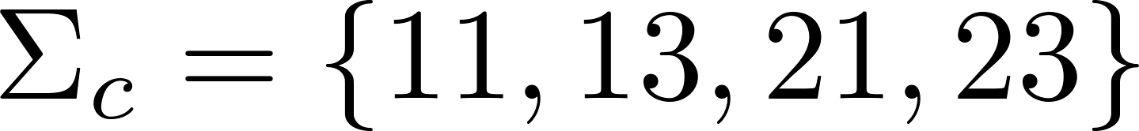

Small Factory: extended
2-slot
11
10
21
20
0
i1
i0
i3
1
2
i2

Slide 4
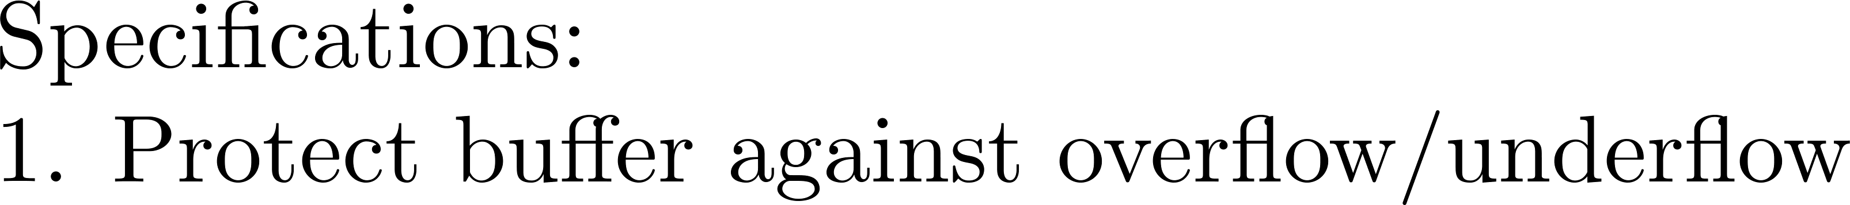

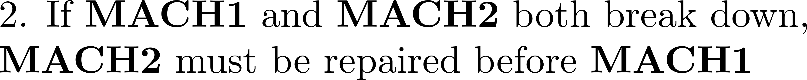

Small Factory: extended
10
10
0
1
2
21
21
13
22
0
1
23

Slide 5
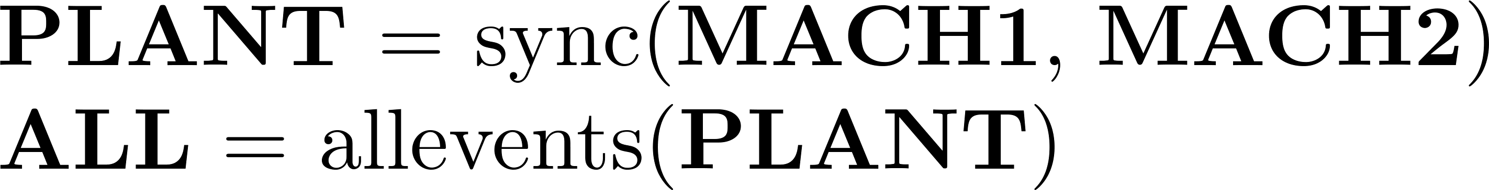
Small Factory: extended

Slide 6
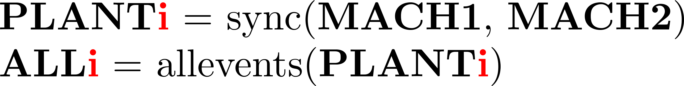
Small Factory: extended

Slide 7
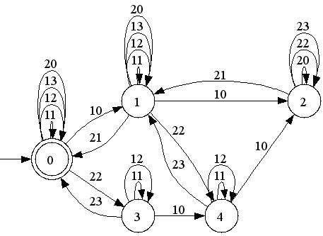
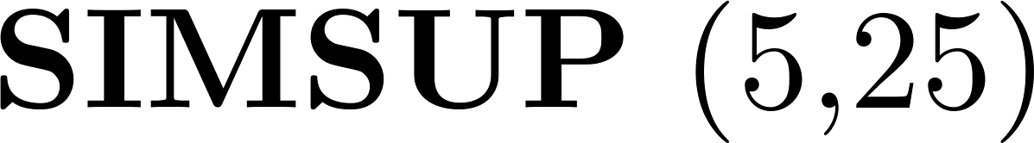
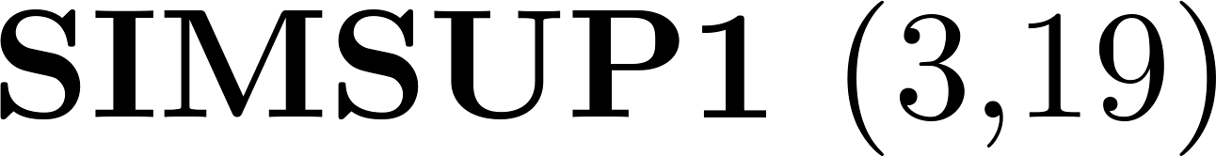
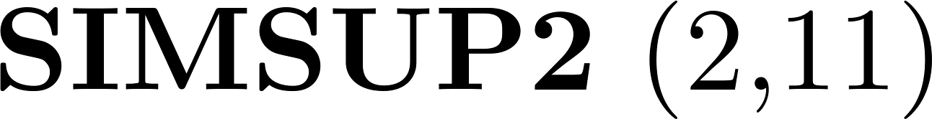
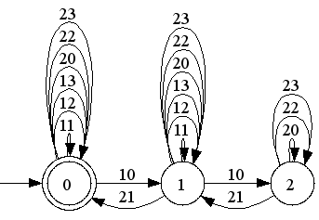
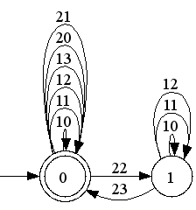
Small Factory: extended

Slide 8

Small Factory: extended

Slide 9
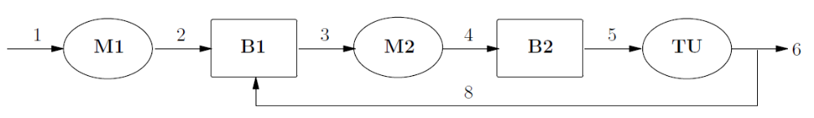
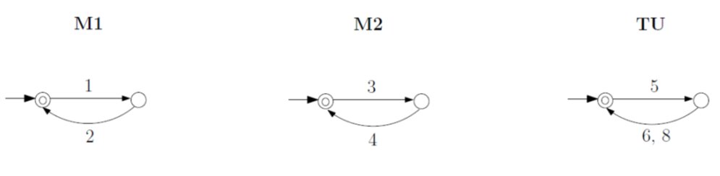
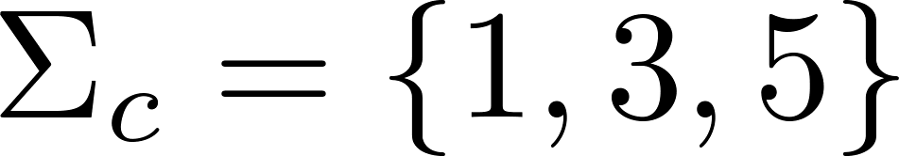
Transfer Line
1-slot
1-slot

Slide 10
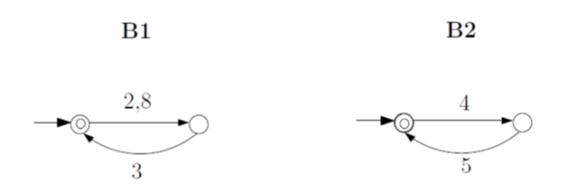
Transfer Line
1-slot
1-slot

Slide 11

Transfer Line

Slide 12

Transfer Line

Slide 13
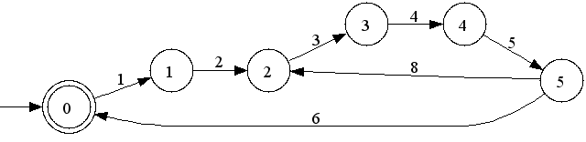
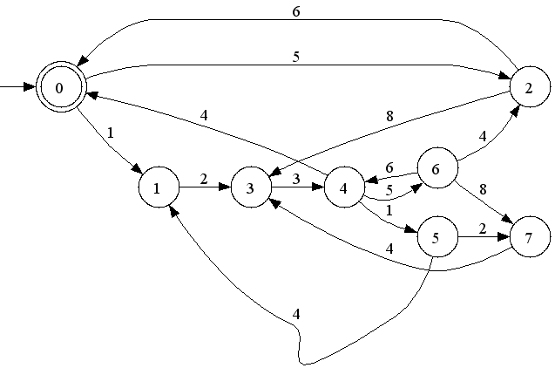
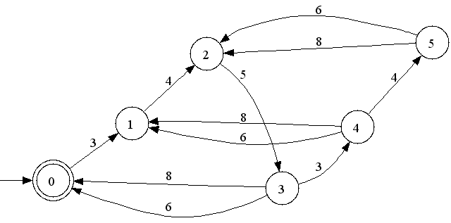
Transfer Line

Slide 14

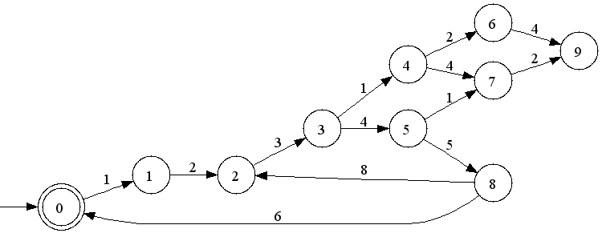
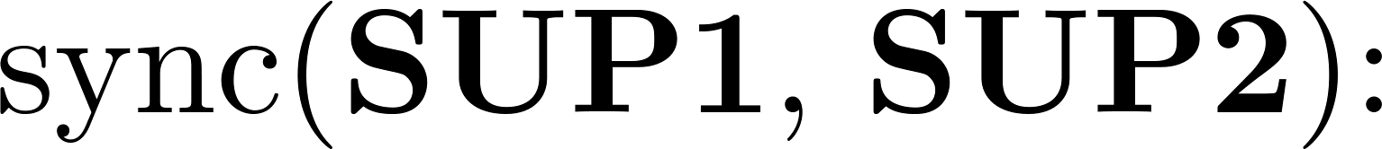
Transfer Line

Slide 15
Transfer Line

Slide 16
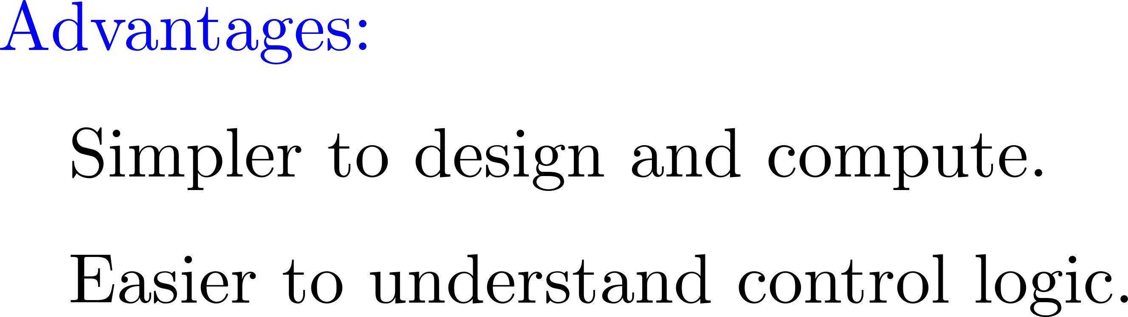
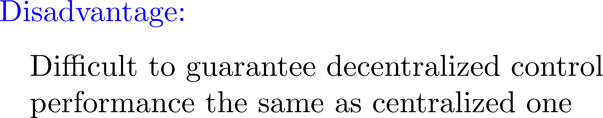
Decentralized supervision

Slide 17
Main question

Slide 18
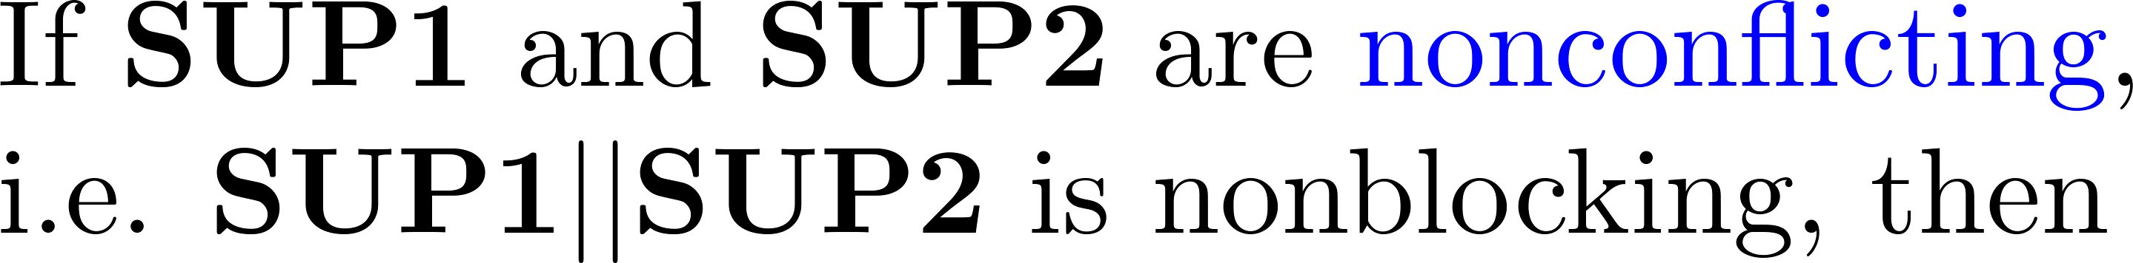
The answer

Slide 19



In terms of languages

Slide 20

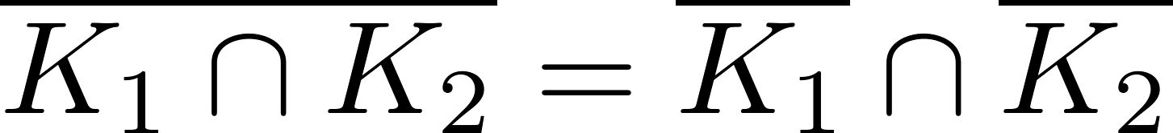
A corollary

Slide 21
Small Factory: extended

Slide 22
Transfer Line

Slide 23
Resolving conflict

Slide 24
Coordinator design

Slide 25
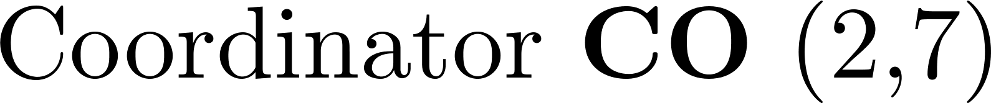
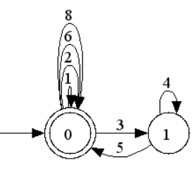
Transfer Line

Slide 26

Transfer Line
1

Slide 27


Control architectures
SUP
G
CO
SUP1
SUP2
SUP1
SUP2
G
G

