Slide 1
Supervisory Control Theory
-- examples

Slide 2
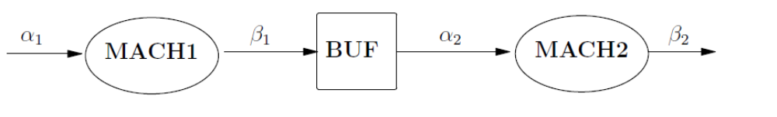


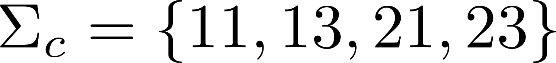

Small Factory: extended
2-slot
11
10
21
20
0
i1
i0
i3
1
2
i2

Slide 3


Small Factory: extended
2-slot
11
10
21
20
10
10
0
1
2
21
21

Slide 4

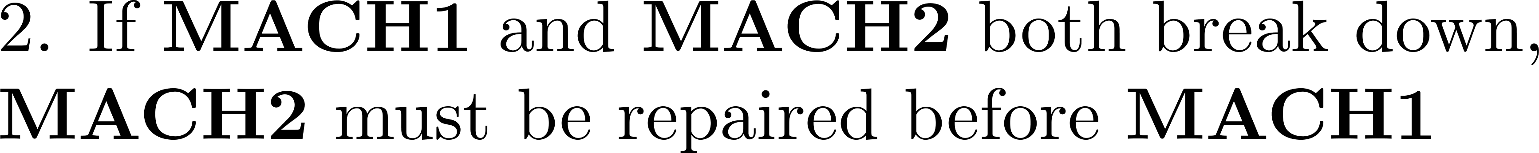

Small Factory: extended
2-slot
11
10
21
20
13
22
0
1
23

Slide 5
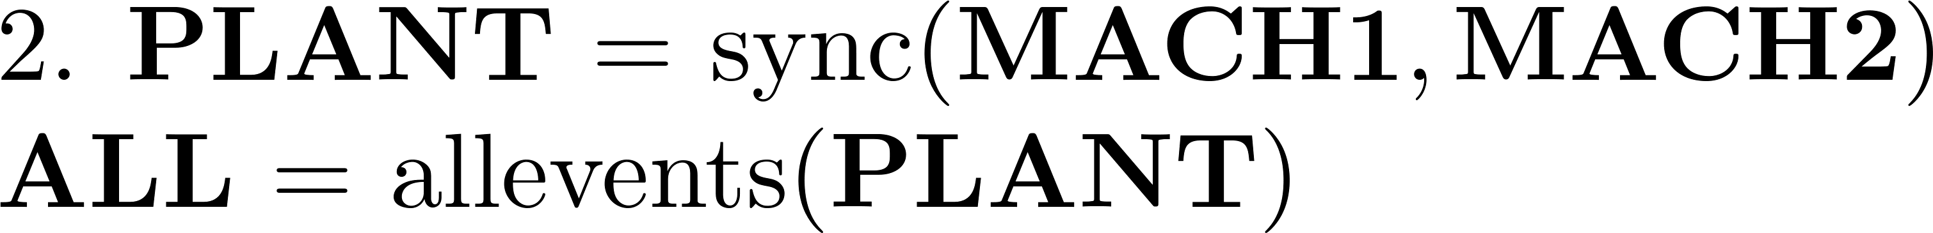
MatlabTCT procedure

Slide 6
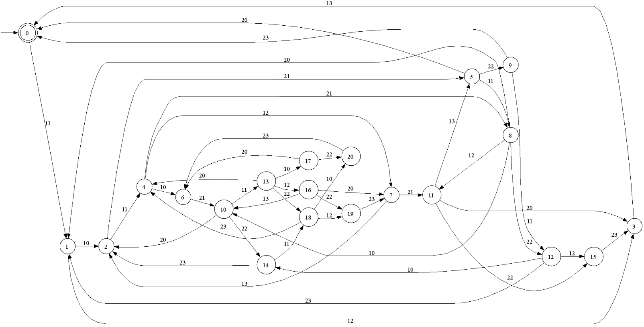
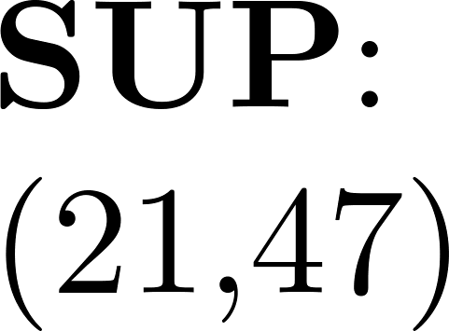
Small Factory: extended
2-slot
11
10
21
20

Slide 7
21
21
21

Slide 8
11
13
13

Slide 9

Supervisor reduction

Slide 10
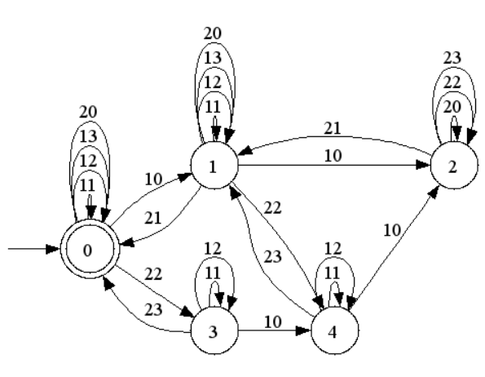

Small Factory: extended
2-slot
11
10
21
20
21
11
13

Slide 11
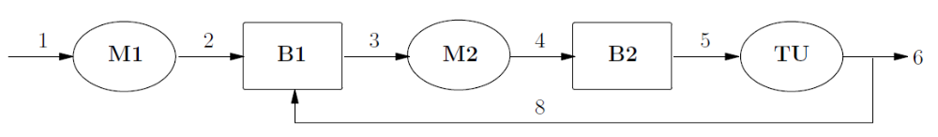
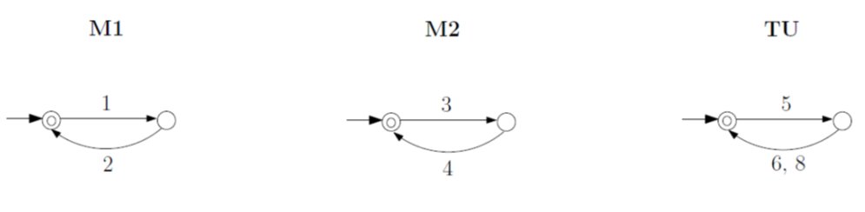

Transfer Line

Slide 12
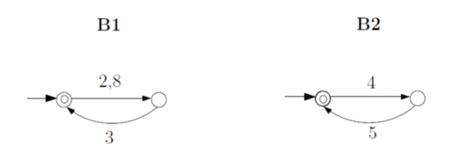
Transfer Line

Slide 13

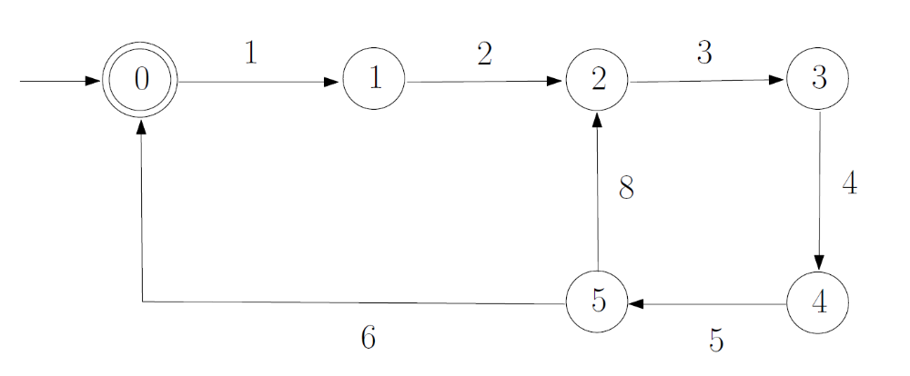
Transfer Line
3,5
3,5
1,5
1,5
1,3
1,3

Slide 14

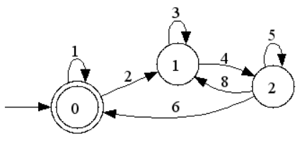
Transfer Line
1,5
3,5
1,3

Slide 15







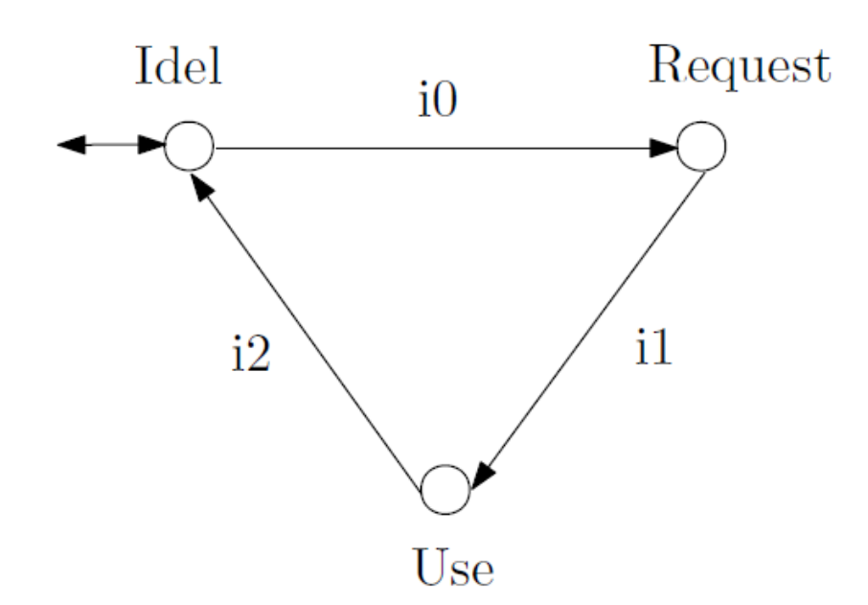
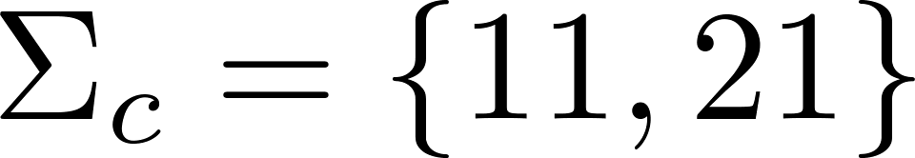
Resource allocation

Slide 16
Resource allocation
21
11
2
0
1
22
12

Slide 17
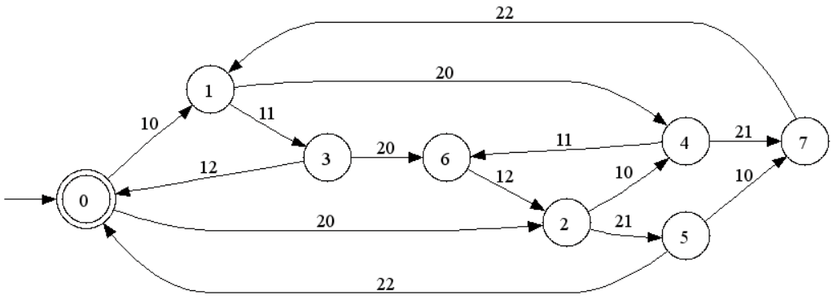
Resource allocation
11
21

Slide 18
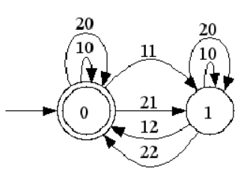
Resource allocation
11,21

Slide 19
Resource allocation: extended

Slide 20
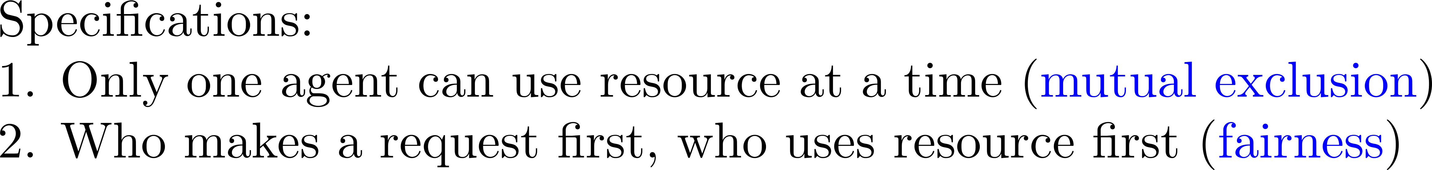
Resource allocation: extended
20
1
3
11
10
11
0
20
21
21
2
4
10

Slide 21
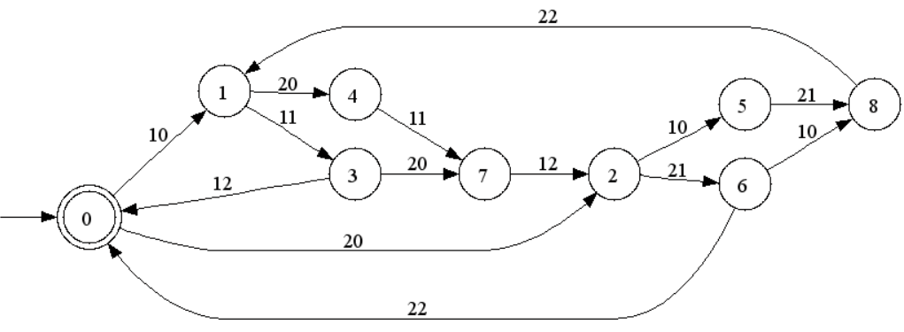
Resource allocation: extended
21
11
11
21

Slide 22
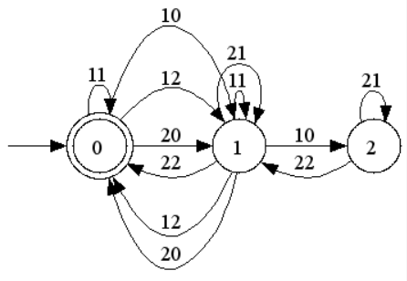
Resource allocation: extended
21
11

Slide 23






Guideway
1
2
3
4
Sta. A
Sta. B
Red
train
11
13
10
15
12
5
0
1
2
3
4
Green
train
21
23
20
25
22
5
0
1
2
3
4

Slide 24

Guideway
1
2
3
4
Sta. A
Sta. B

Slide 25
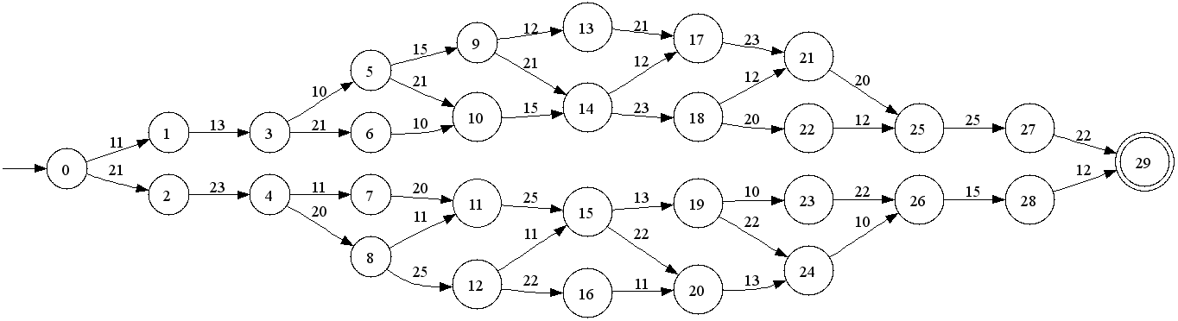
Guideway
1
2
3
4
Sta. A
Sta. B

Slide 26
21
11

Slide 27
23
23
13
13

Slide 28
25
15

Slide 29
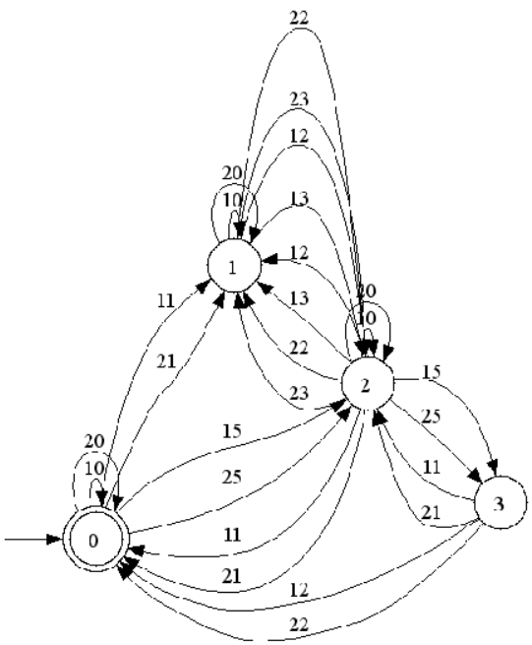
Guideway
11,21
15,25
13,23

