Slide 1
Supervisory Control Theory
-- continued

Slide 2
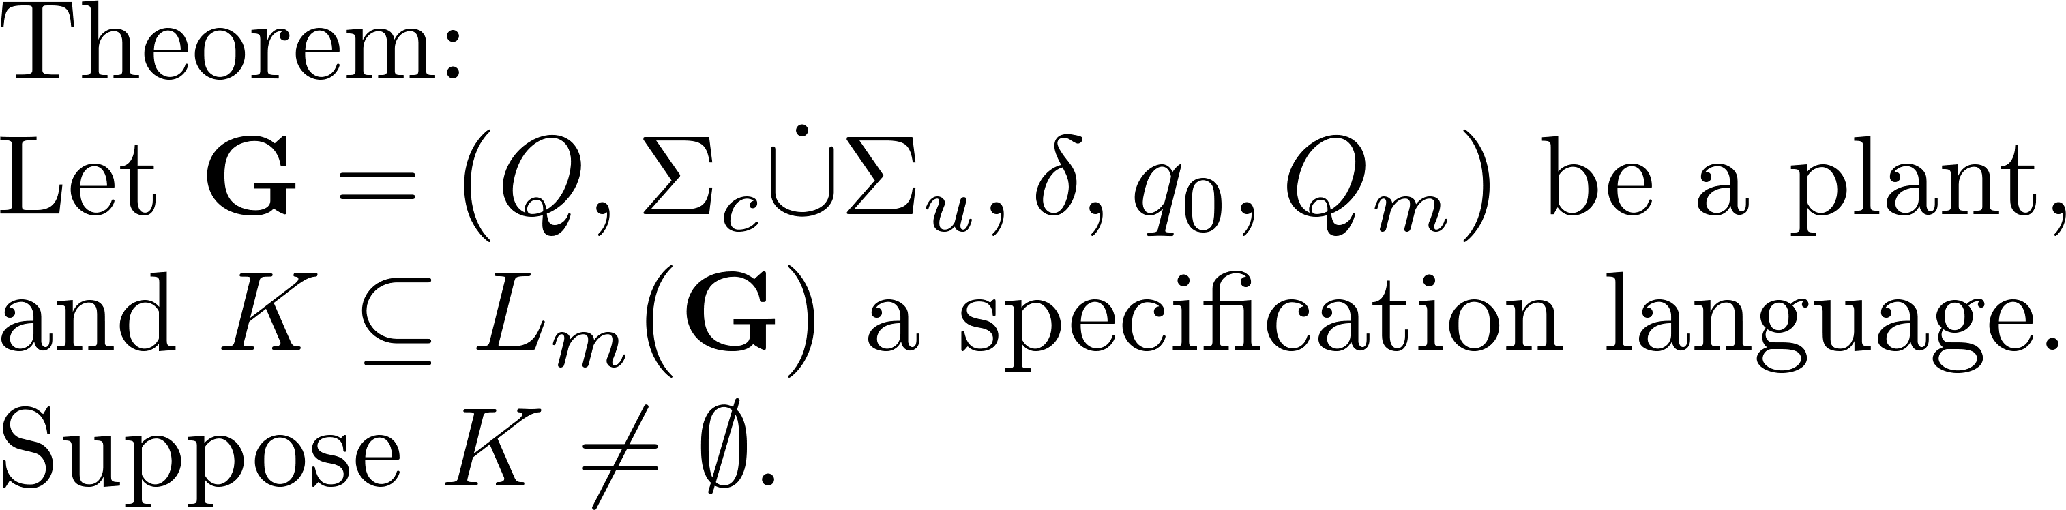
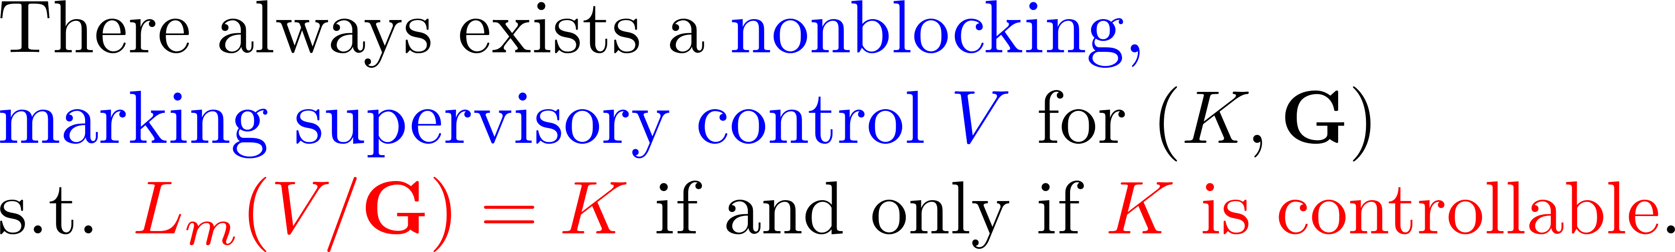
Main result of supervisory control

Slide 3
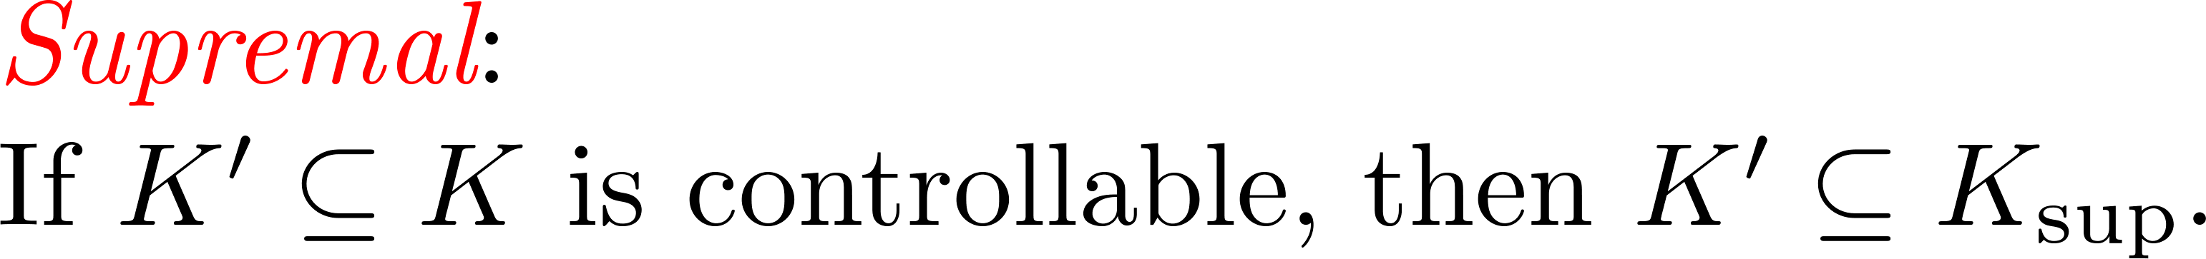
Optimal supervisory control

Slide 4
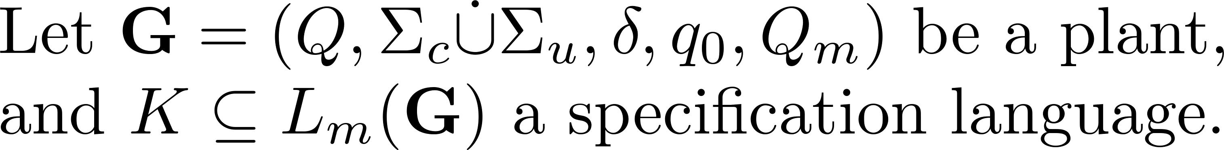
Family of controllable sublanguages

Slide 5
Family of controllable sublanguages

Slide 6
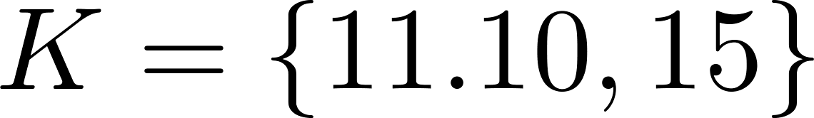
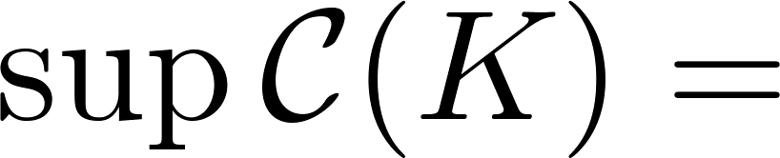
A coffee machine
15
0
3
11
10
13
1
2
12

Slide 7
A coffee machine
15
0
3
11
10
13
1
2
12

Slide 8
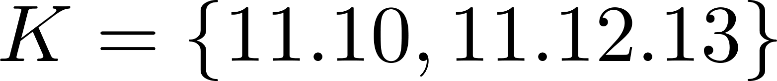
A coffee machine
15
0
3
11
10
13
1
2
12

Slide 9
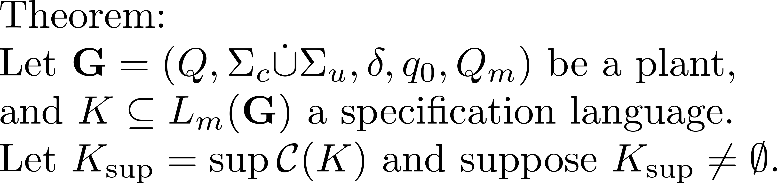
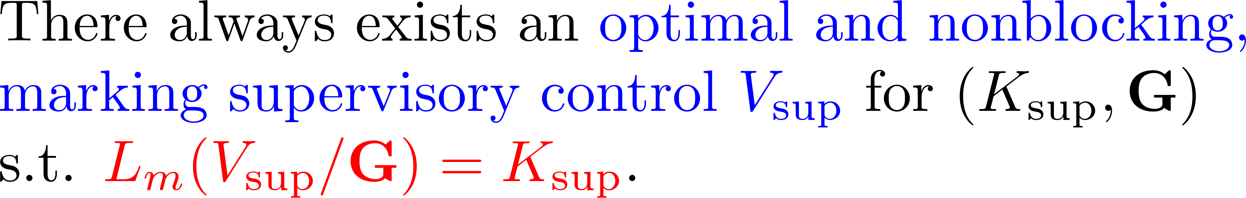
Optimal supervisory control: result

Slide 10

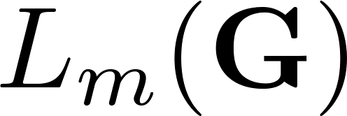

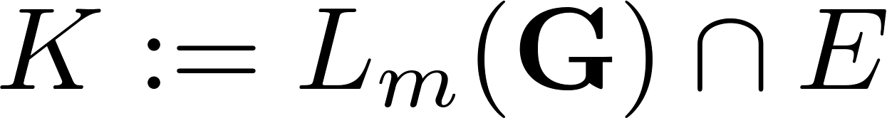

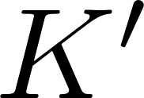
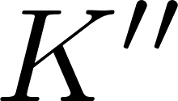

Structural lattice
(all strings)
Given:
(marked
language of plant)
(specification language)
optimization
Want to
compute:
(optimal)
(suboptimal)
(no strings)

Slide 11
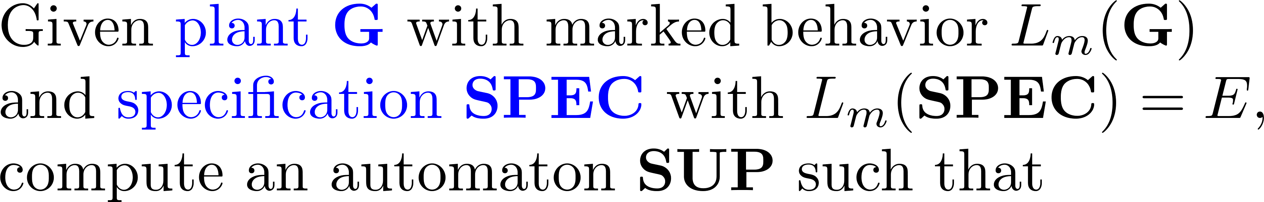
Optimal supervisor

Slide 12
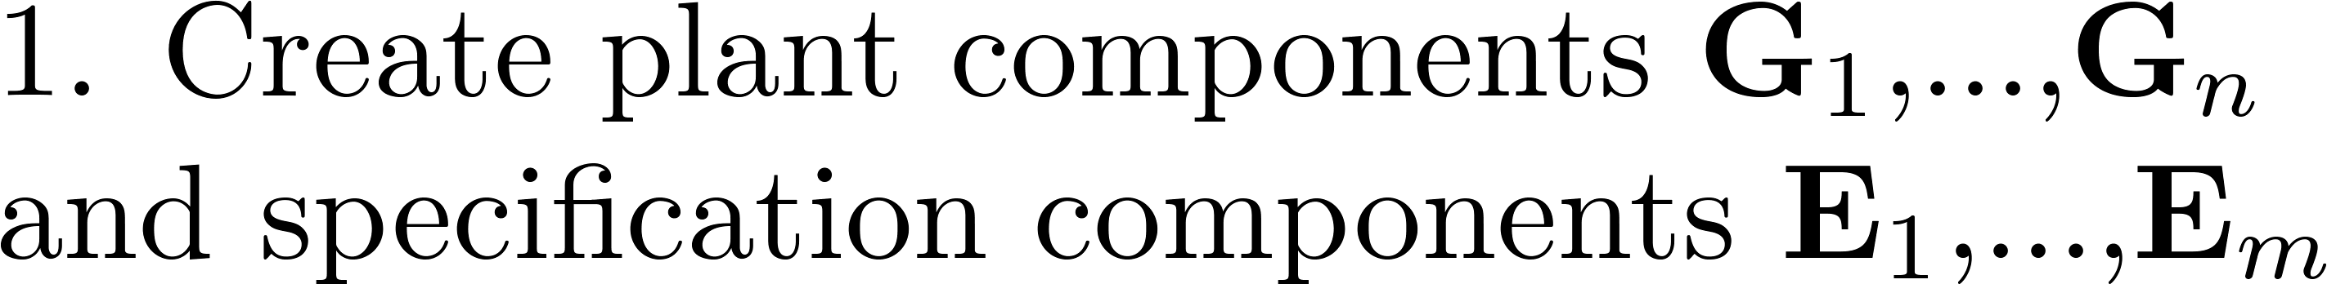
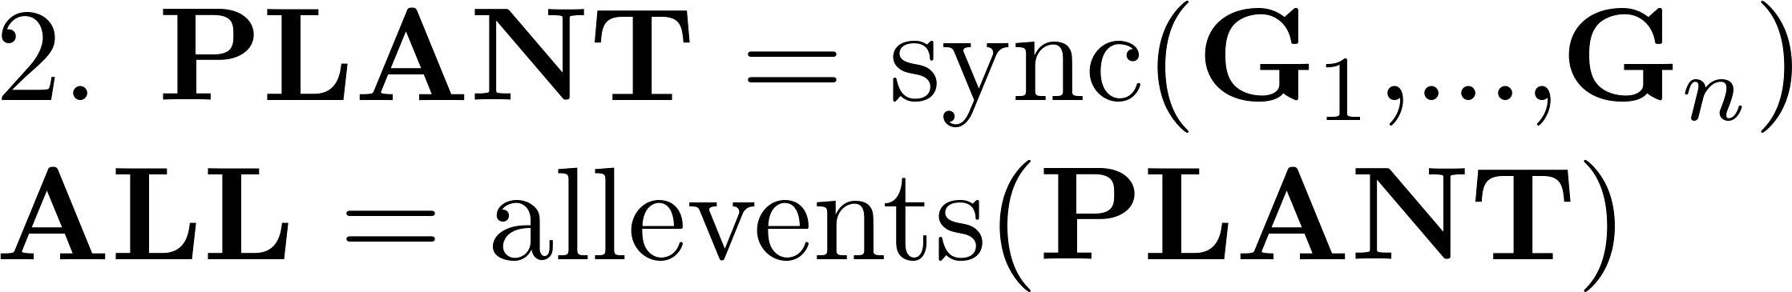
Optimal supervisor by MatlabTCT

Slide 13
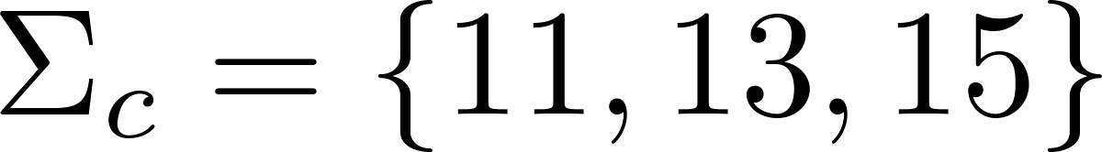
A coffee machine
States:
15
Idel: 0
0
3
Brewing: 1
11
Broken: 2
10
13
Sold: 3
1
2
12

Slide 14

A coffee machine
11
15
12
0
1

Slide 15

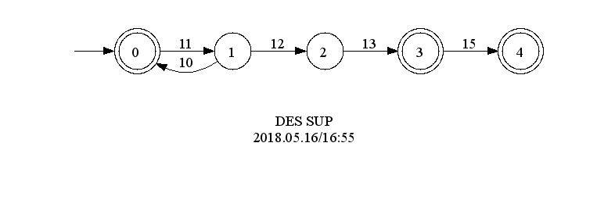
A coffee machine
supcon(‘SUP',‘PLANT',‘SPEC'); % compute supervisor
displaydes(‘SUP'); % display supervisor

Slide 16
A coffee machine
condat(‘SUPDAT',‘PLANT',‘SUP'); % compute supervisor’s control data
Open SUPDATA.txt: 0: 15
4: 11
15
11

Slide 17
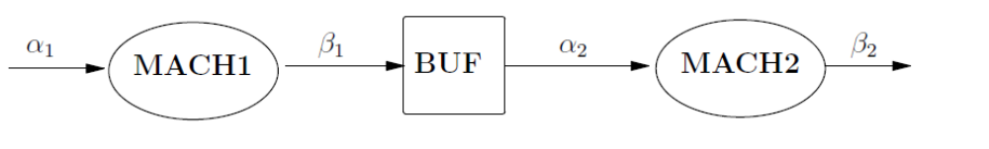
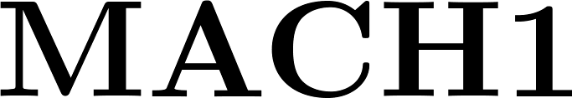

Small Factory
2-slot
11
10
21
20
0
0
11
10
21
20
1
1

Slide 18
Small Factory
2-slot
11
10
21
20
11
0,0
21
10
20
1,0
0,1
20
10
21
1,1
11

Slide 19
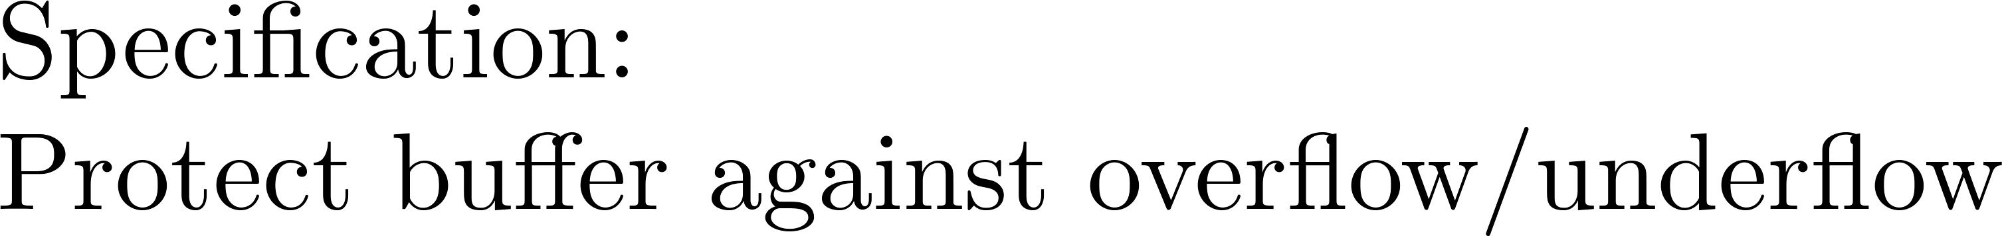
Small Factory
2-slot
11
10
21
20
10
10
0
1
2
21
21

Slide 20
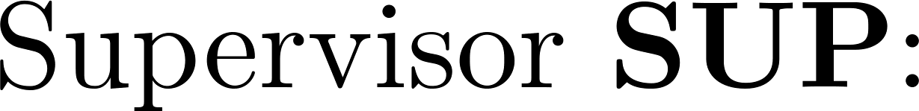
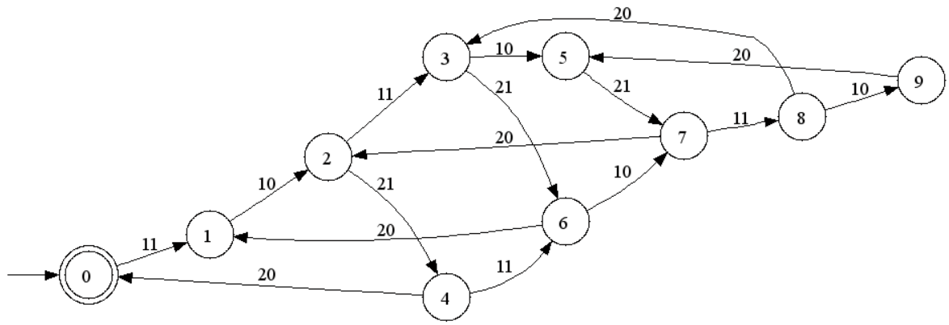
Small Factory
2-slot
11
10
21
20
11
11
21
21

