Slide 1
Supervisory Control Theory
-- continued

Slide 2
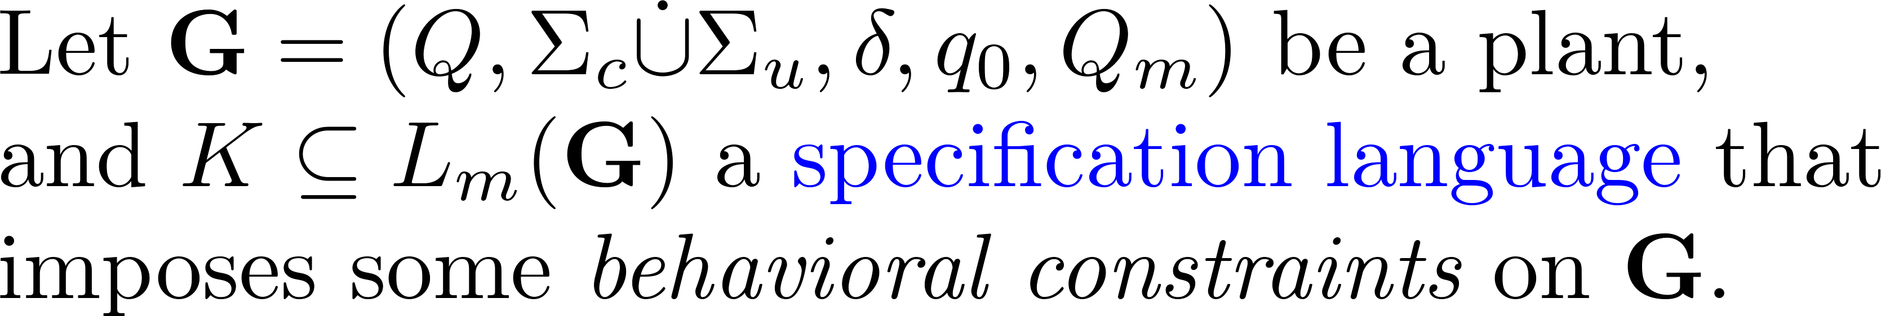
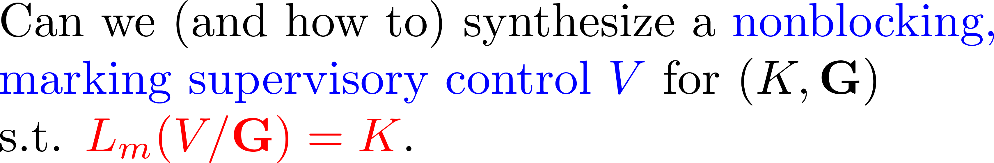
Main question

Slide 3
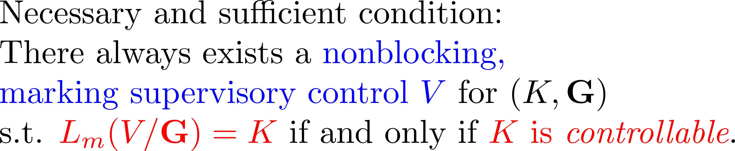
The answer

Slide 4
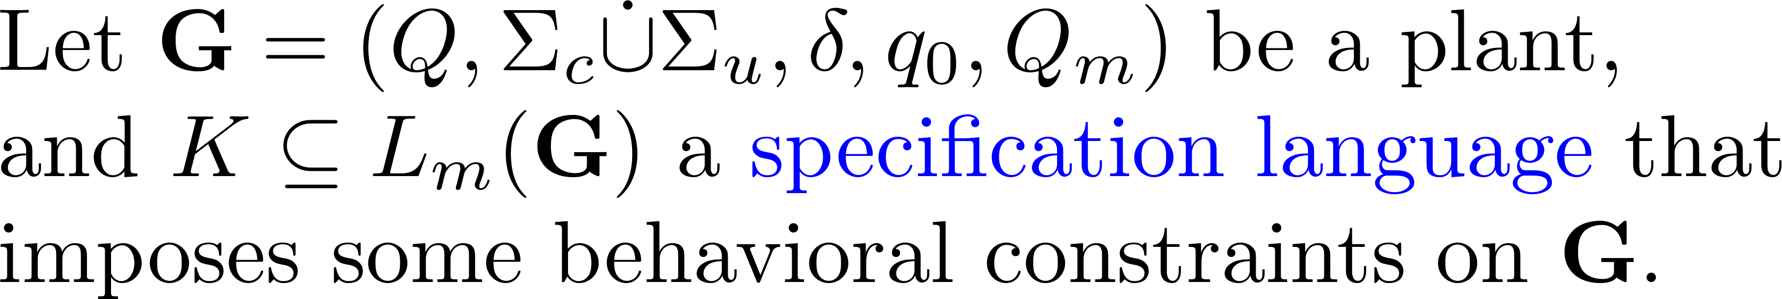

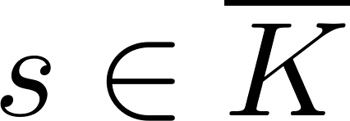

Controllability

Slide 5


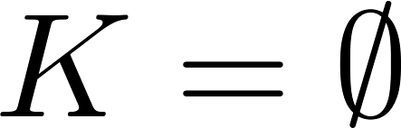
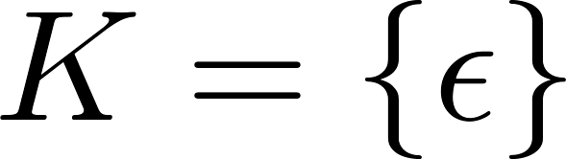
Examples

Slide 6
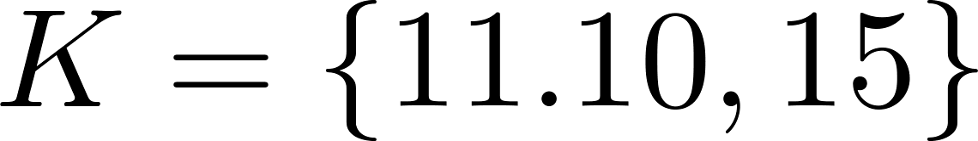
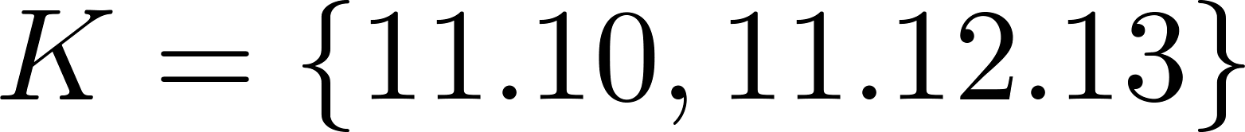
A coffee machine
States:
15
Idle: 0
0
3
Brewing: 1
11
Broken: 2
10
13
Sold: 3
1
2
12

Slide 7
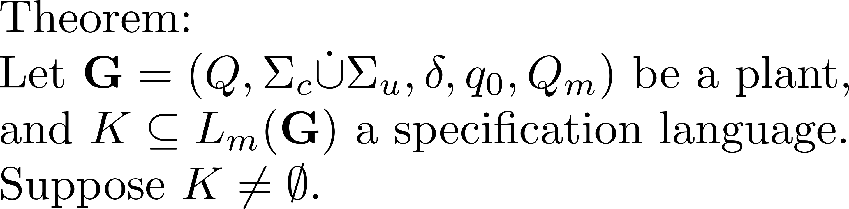
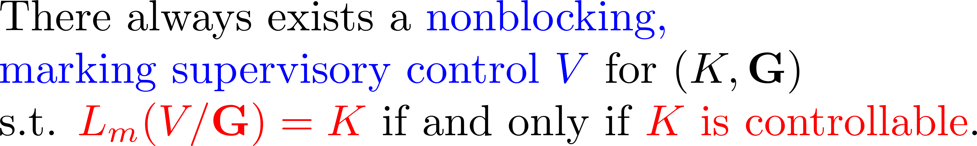
Main result

Slide 8
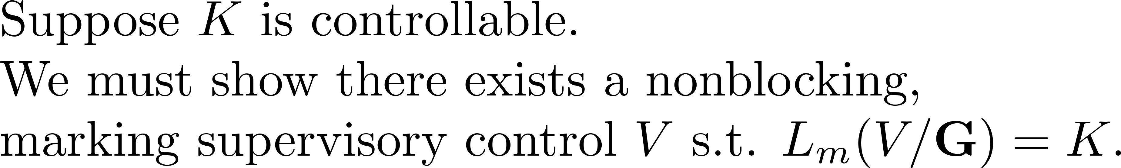
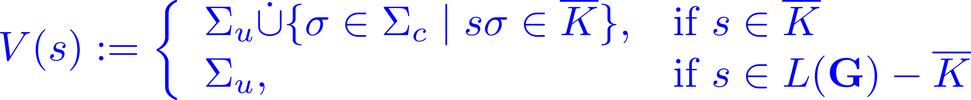
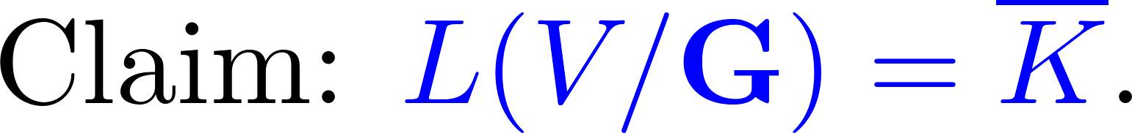
Proof (sufficiency)

Slide 9
Proof (sufficiency)

Slide 10
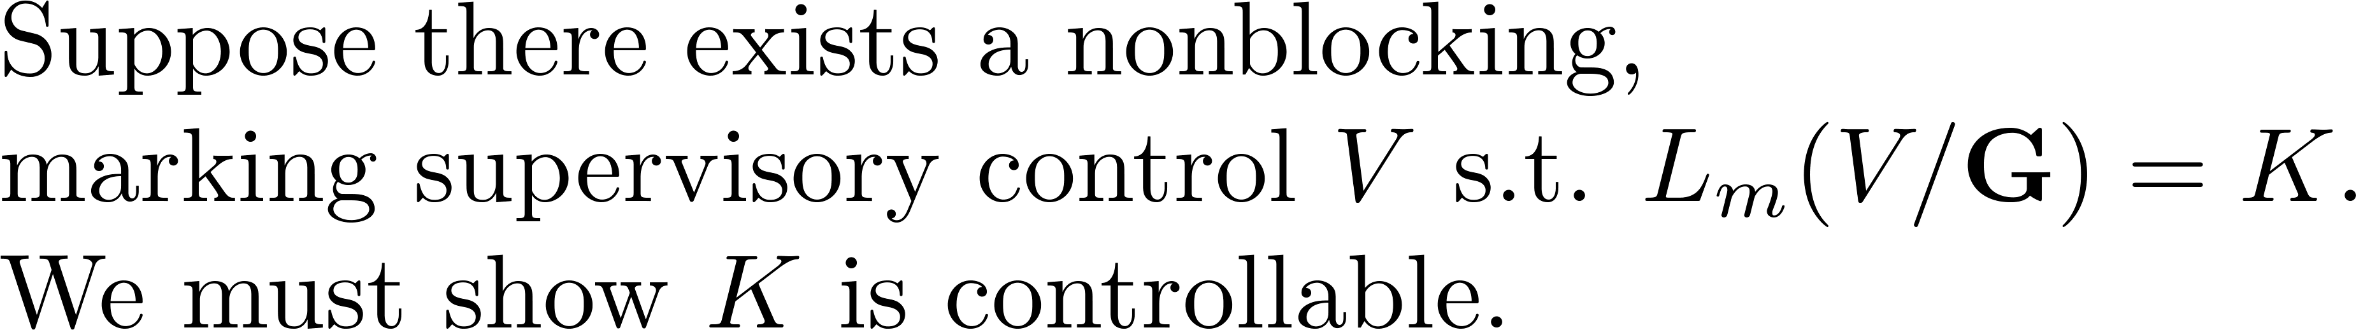
Proof (necessity)

Slide 11
A coffee machine
15
0
3
11
10
13
1
2
12

Slide 12
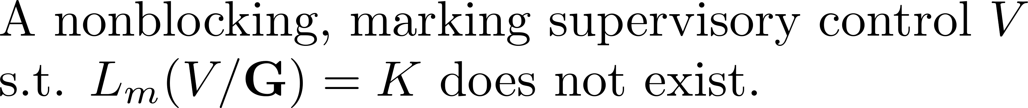
A coffee machine
15
0
3
11
10
13
1
2
12

