Slide 1
Supervisory Control Theory

Slide 2
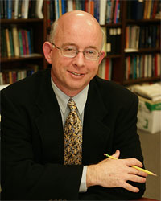
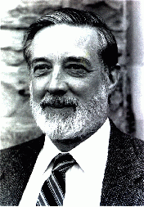
Supervisory control theory for DES
P.J. Ramadge
W.M. Wonham
proposed by RW in 1982

Slide 3
Supervisory control theory

Slide 4
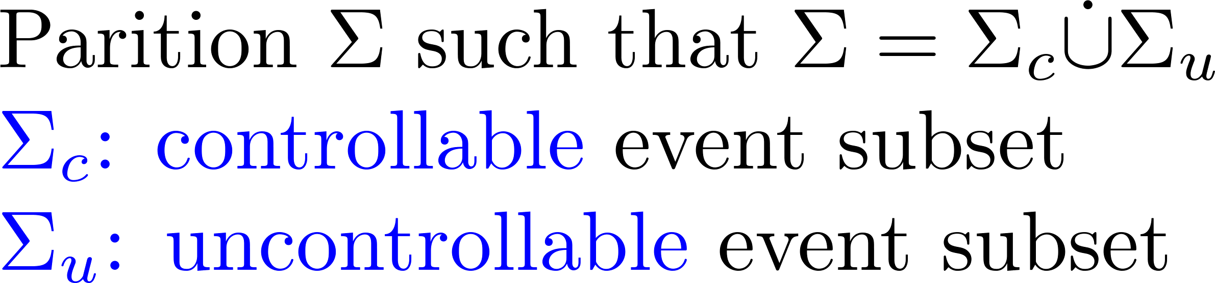
Control technology

Slide 5

A coffee machine
States:
15
Idle: 0
0
3
Brewing: 1
11
Broken: 2
10
13
Sold: 3
1
2
12

Slide 6
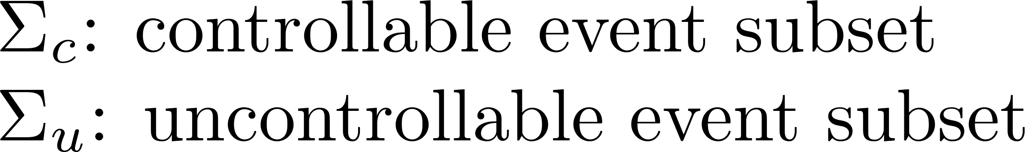


Control pattern

Slide 7


A coffee machine
States:
15
Idle: 0
0
3
Brewing: 1
11
Broken: 2
10
13
Sold: 3
1
2
12

Slide 8
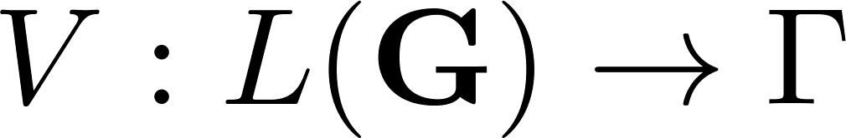
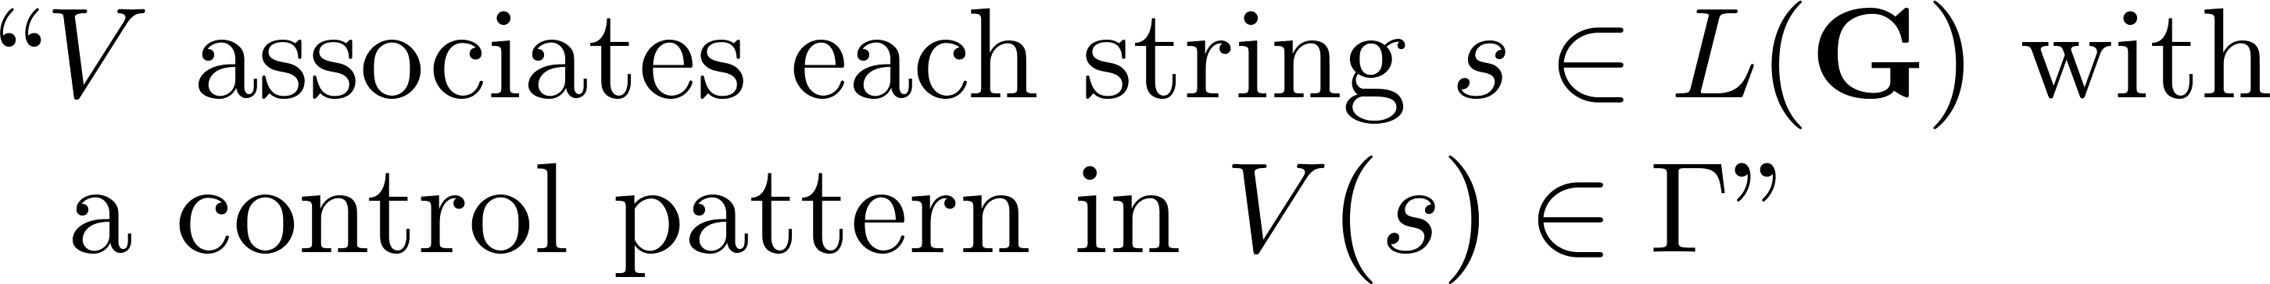
Supervisory control

Slide 9





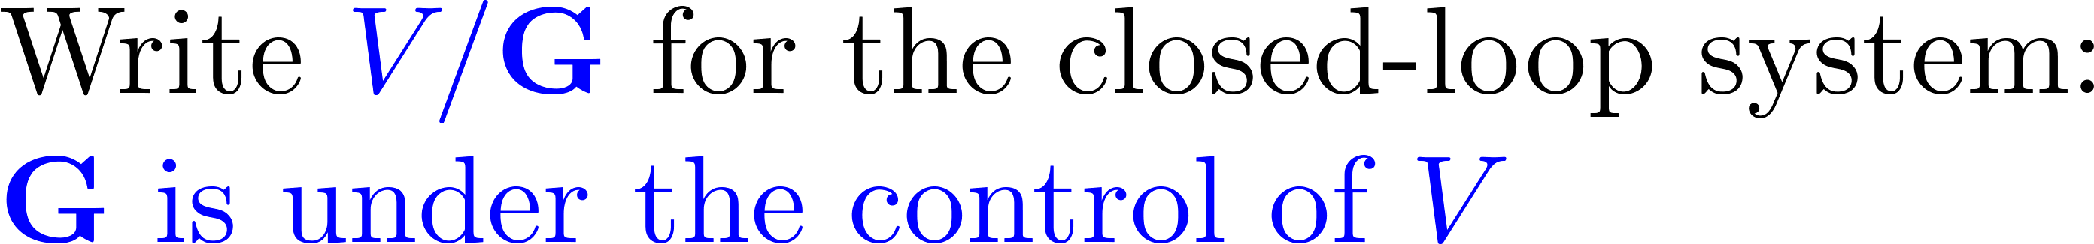
Feedback control loop

Slide 10
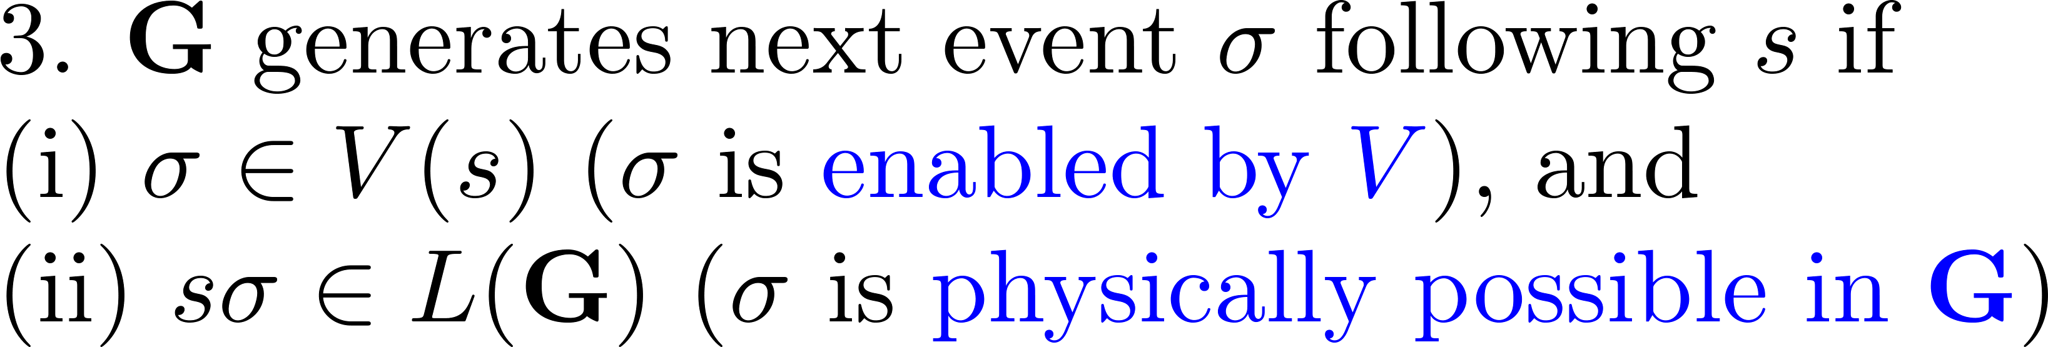
Feedback control loop

Slide 11
A coffee machine
States:
15
Idle: 0
0
3
Brewing: 1
11
Broken: 2
10
13
Sold: 3
1
2
12

Slide 12
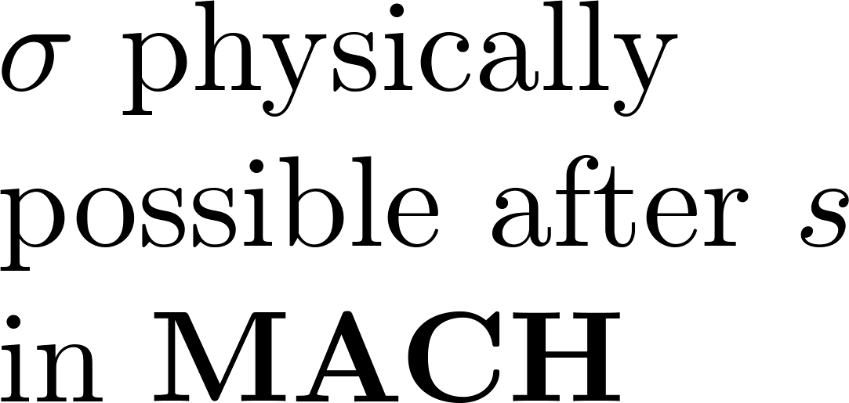



A coffee machine
15
0
3
11
10
13
1
2
12

Slide 13


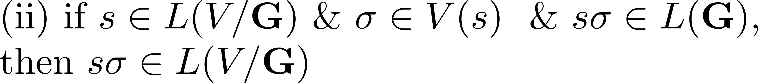
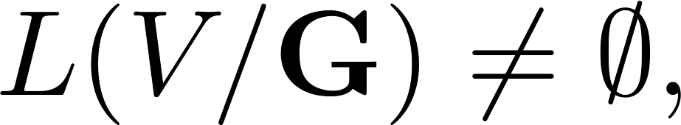
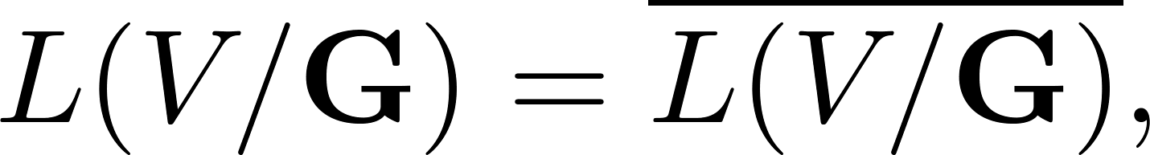

Closed behavior of

Slide 14

Marked behavior of

Slide 15
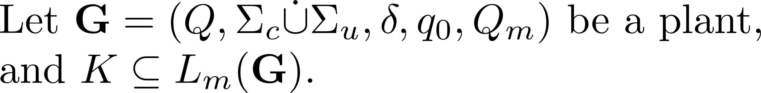
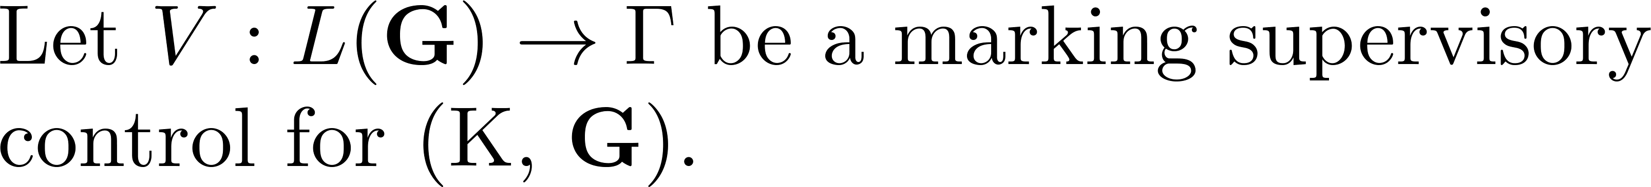

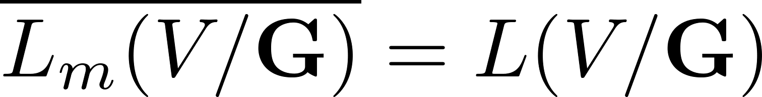
Nonblocking supervisory control

Slide 16
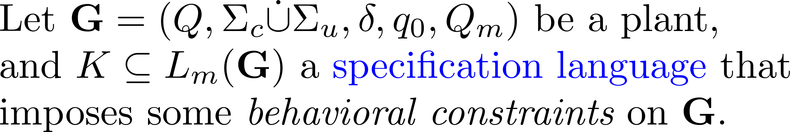
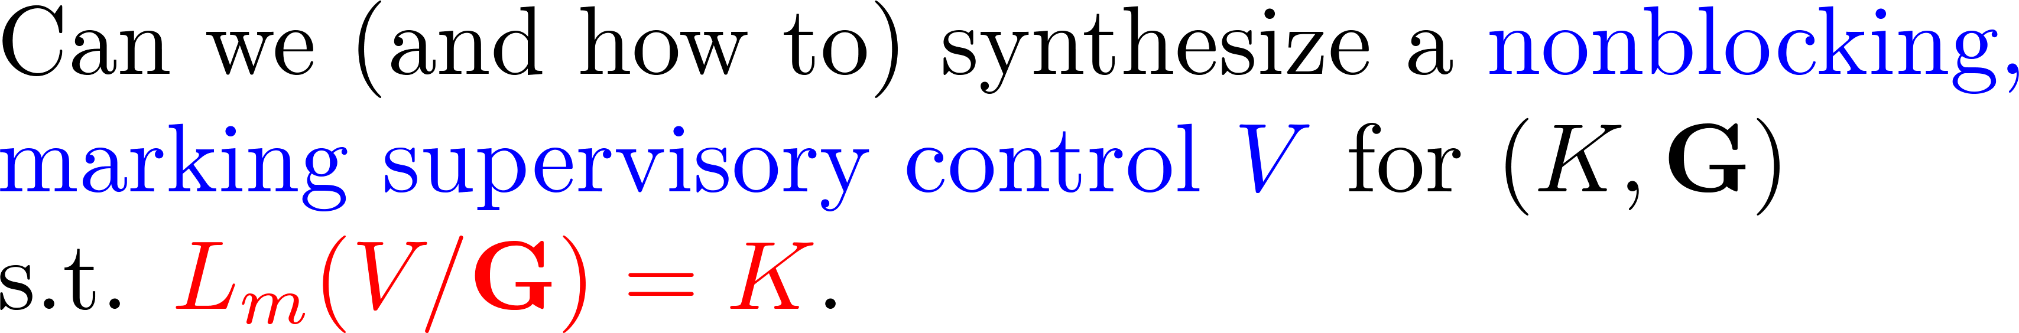
Main question

Slide 17
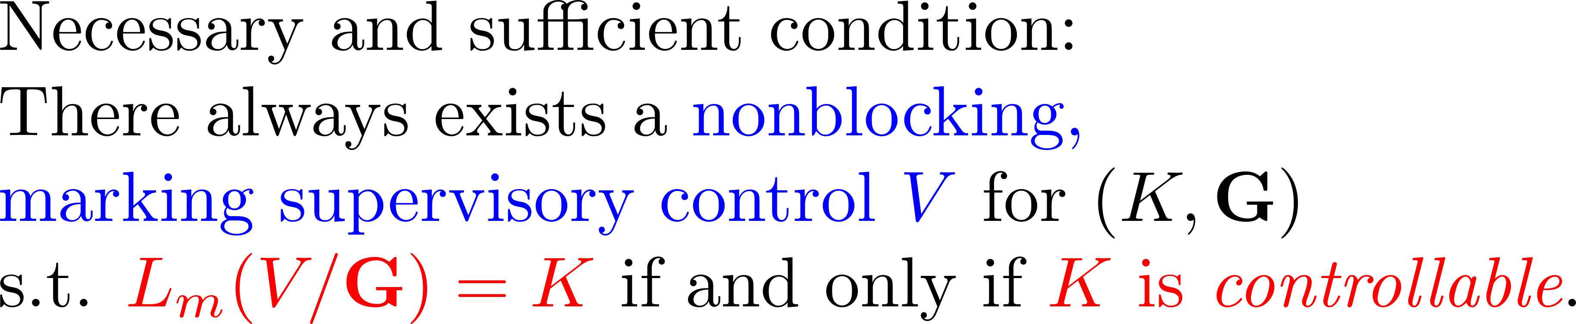
The answer

