Slide 1
Operations on Automata

Slide 2
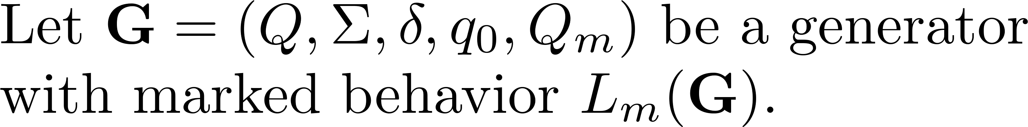
Complement

Slide 3


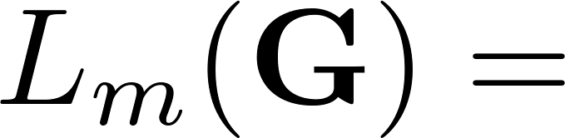
Example

Slide 4
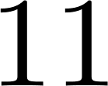
Example

Slide 5
Complement

Slide 6
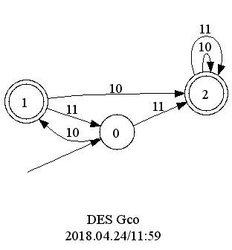
MatlabTCT complement
Q = 2;
Qm = [0];
delta = [0,10,1; 1,11,0];
create('G', Q, delta, Qm); % create automaton
complement('Gco', 'G', []); % selfloop new events
displaydes('Gco'); % display automaton

Slide 7
Selfloop

Slide 8
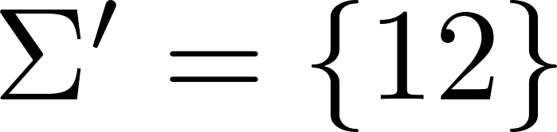
Example

Slide 9
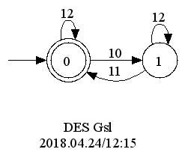
MatlabTCT selfloop
Q = 2;
Qm = [0];
delta = [0,10,1; 1,11,0];
create('G', Q, delta, Qm); % create automaton
selfloop('Gsl', 'G', [12, 13]); % selfloop new events
displaydes('Gsl'); % display automaton

Slide 10
Selfloop

Slide 11
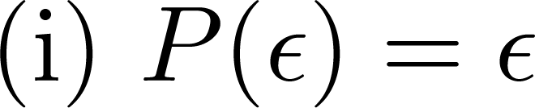





Natural projection

Slide 12
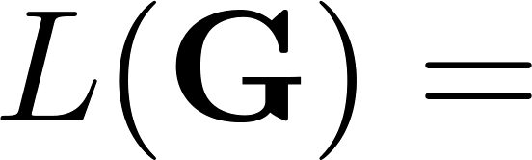
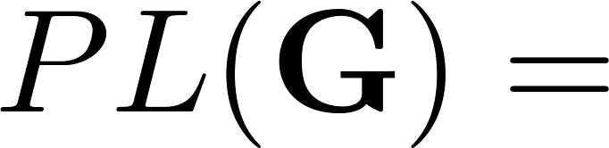
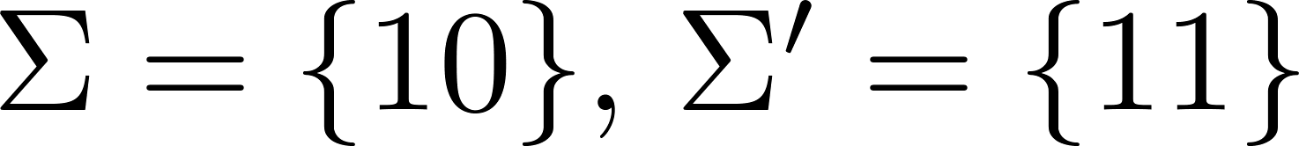
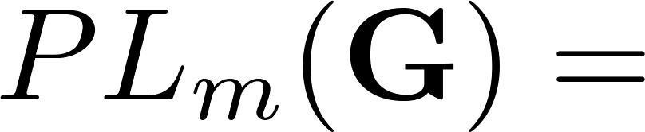
Natural projection

Slide 13
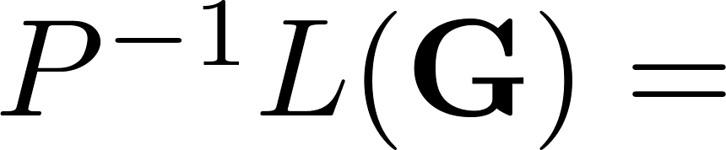
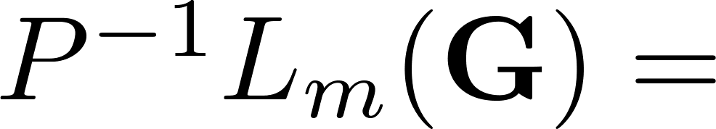
Inverse image of natural projection

Slide 14

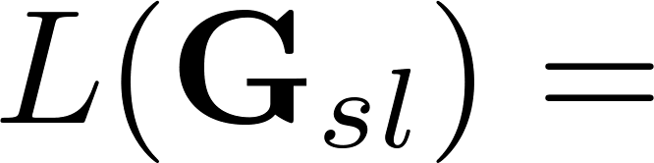

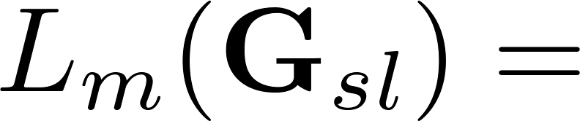
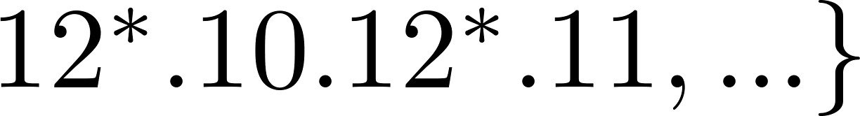
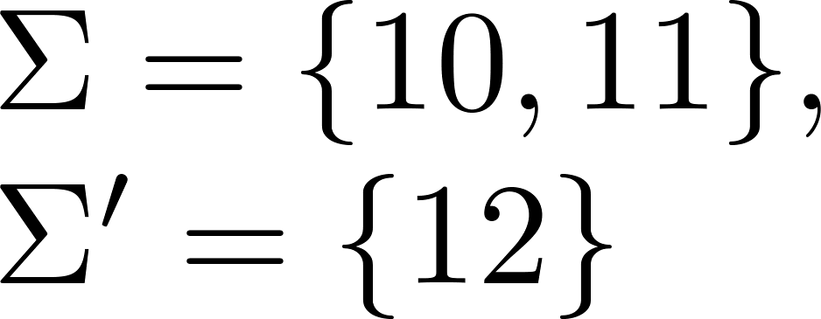

Slide 15

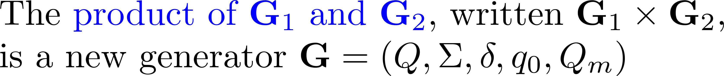
Product of automata

Slide 16



Example
0
1
0
1
2

Slide 17
MatlabTCT meet
Q1 = 3;
Qm1 = [0];
delta1 = [0,10,1; 1,10,2; 2,10,0];
create('G1', Q1, delta1, Qm1); % create 1st automaton
Q2 = 2;
Qm2 = [0];
delta2 = [0,10,1; 1,10,0];
create('G2', Q2, delta2, Qm2); % create 2nd automaton

Slide 18
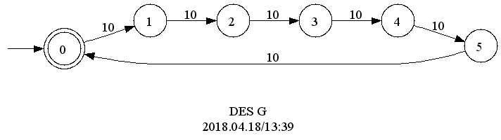
MatlabTCT meet
meet('G','G1','G2'); % product of two automata
displaydes('G'); % display automaton

Slide 19
Product of automata

Slide 20
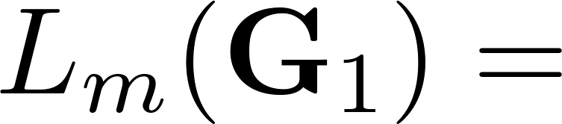
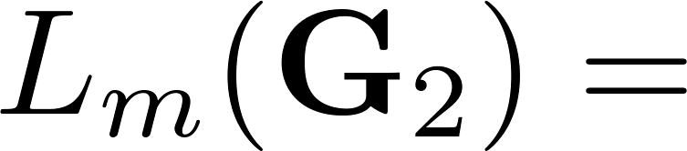
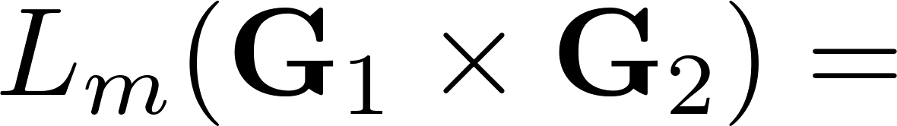
Example
0
1
0
1
2

Slide 21
“Union” of automata

Slide 22
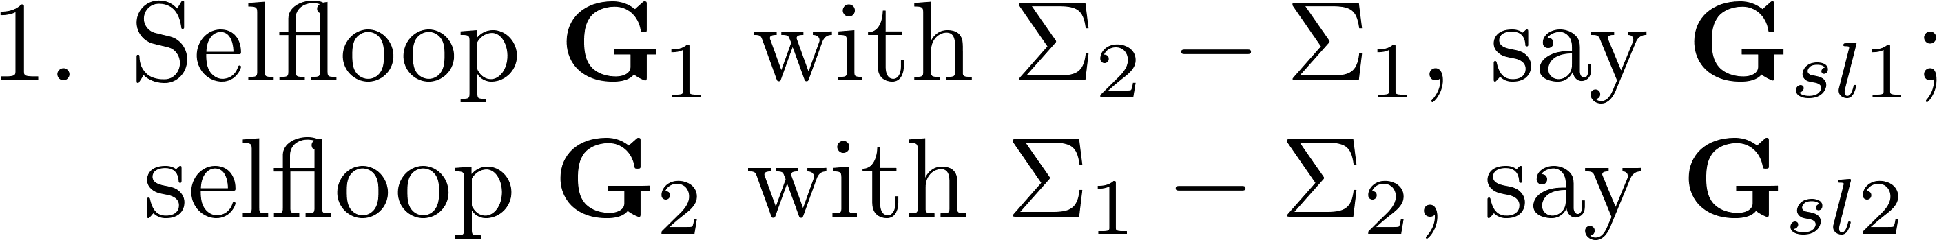
Synchronous product of automata

Slide 23
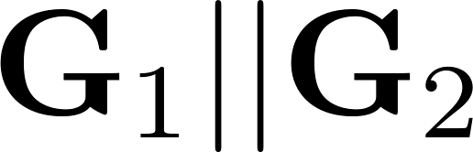
Example
0
1
0
1
2

Slide 24
MatlabTCT sync
Q1 = 3;
Qm1 = [0];
delta1 = [0,11,1; 1,10,2; 2,10,0];
create('G1', Q1, delta1, Qm1); % create 1st automaton
Q2 = 2;
Qm2 = [0];
delta2 = [0,10,1; 1,12,0];
create('G2', Q2, delta2, Qm2); % create 2nd automaton

Slide 25
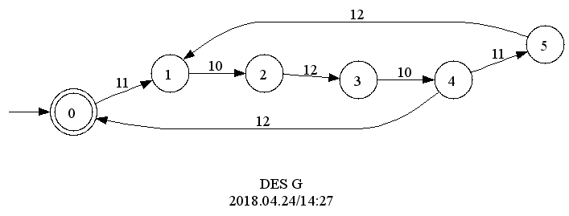
MatlabTCT sync
sync('G','G1','G2'); % product of two automata
displaydes('G'); % display automaton

Slide 26

Synchronous product of automata

Slide 27
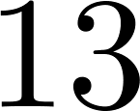
Event blocking
0
1
1
0
1
1

Slide 28
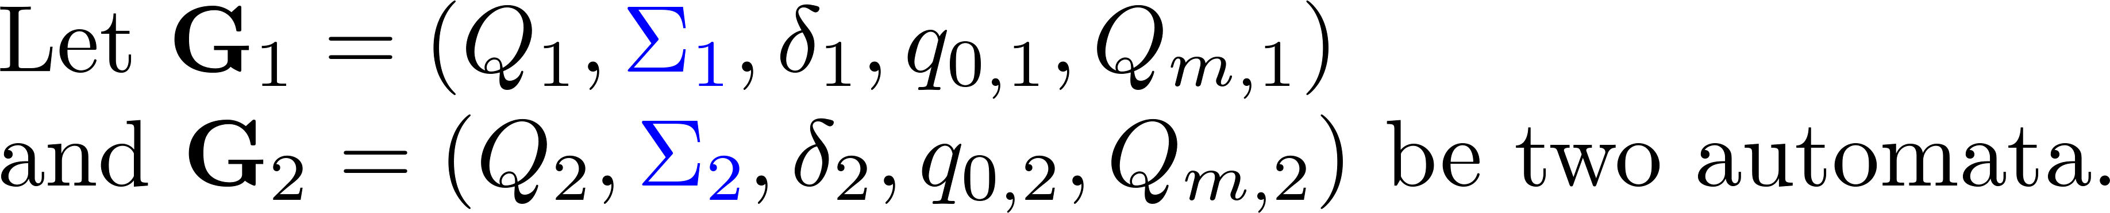
Nonconflicting

Slide 29
MatlabTCT nonconflicting
Q1 = 3;
Qm1 = [2];
delta1 = [0,12,0; 0,10,1; 1,11,2];
create('G1', Q1, delta1, Qm1); % create 1st automaton
Q2 = 3;
Qm2 = [2];
delta2 = [0,13,0; 0,11,1; 1,10,2];
create('G2', Q2, delta2, Qm2); % create 2nd automaton

Slide 30
MatlabTCT nonconflicting
Method 1:
sync('G','G1','G2'); % product of two automata
allevents(‘ALL','G'); % all events of G
nonconflict('G','ALL'); % check if G and ALL are nonconflicting, i.e. if G is blocking

Slide 31
MatlabTCT nonconflicting
Method 2:
selfloop('Gsl1','G1',[13]); % selfloop 13 to G1
selfloop('Gsl2','G2',[12]); % selfloop 12 to G2
nonconflict('Gsl1','Gsl2'); % check if Gsl1 and Gsl2 are nonconflicting

