Slide 1
Automata

Slide 2
A car
States:
15
0
4
Parked: 0
Running: 1
10
Broken: 2
11
13
Junk: 3
Missing: 4
1
2
3
12
14
Events:
Turn on engine: 10
Turn off engine: 11
Break down: 12
Repair: 13
Dump: 14
Stolen: 15

Slide 3
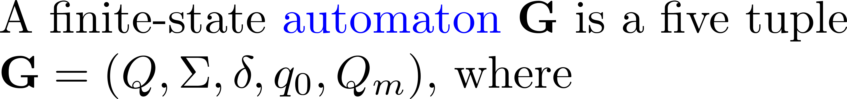

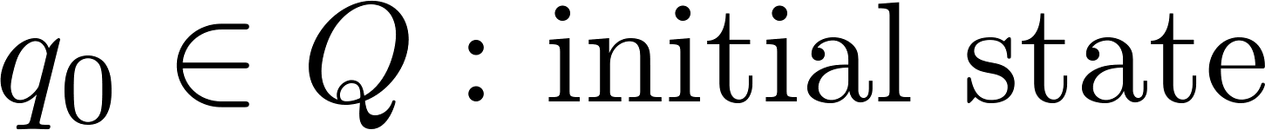
DES model: automata

Slide 4
DES model: automata

Slide 5
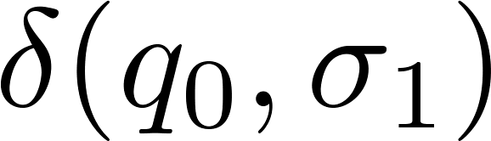
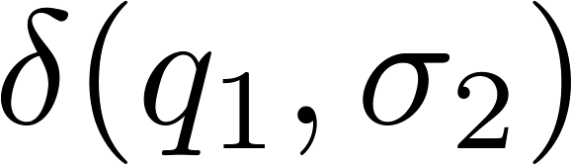

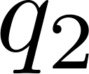





How does an automaton work
Beeps when a transition enters a marker state
Internal state
transitions

Slide 6
A car
States:
Parked: 0
15
0
4
Running: 1
Broken: 2
10
11
13
Junk: 3
Missing: 4
1
2
3
12
14
initial state
marker state
or

Slide 7
A car
States:
Parked: 0
15
0
4
Running: 1
Broken: 2
10
11
13
Junk: 3
Missing: 4
1
2
3
12
14

Slide 8

A car
States:
Parked: 0
15
0
4
Running: 1
Broken: 2
10
11
13
Junk: 3
Missing: 4
1
2
3
12
14

Slide 9
A car
States:
Parked: 0
15
0
4
Running: 1
Broken: 2
10
11
13
Junk: 3
Missing: 4
1
2
3
12
14

Slide 10

State transition function

Slide 11
A car
States:
Parked: 0
15
0
4
Running: 1
Broken: 2
10
11
13
Junk: 3
Missing: 4
1
2
3
12
14

Slide 12
MatlabTCT
create
displaydes

Slide 13
MatlabTCT creat
Q = 5; % number of states
% the initial state q0 is always labeled “0”
Qm = [0,1]; % marker state set
% transition triples [exit state, event, enter state]
delta = [0,10,1; 1,11,0; 1,12,2; 2,13,0; 2,14,3; 0,15,4];
create('CAR', Q, delta, Qm); % create automaton

Slide 14
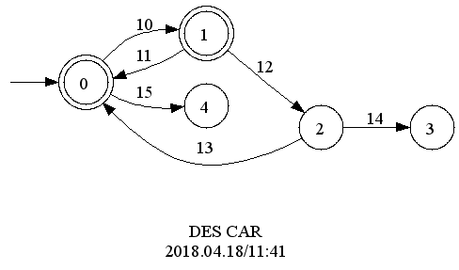
MatlabTCT displaydes
displaydes('CAR') % display automaton

Slide 15
Reachable

Slide 16
Coreachable

Slide 17
Trim

Slide 18
Nonblocking

Slide 19
A car
States:
Parked: 0
15
0
4
Running: 1
Broken: 2
10
11
13
Junk: 3
Missing: 4
1
2
3
12
14

Slide 20
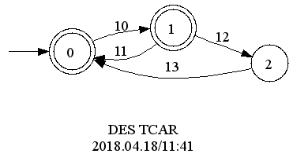
MatlabTCT trim
trim('TCAR', 'CAR'); % trim an automaton
displaydes('CAR') % display automaton

Slide 21
Closed behavior

Slide 22
Marked behavior

Slide 23



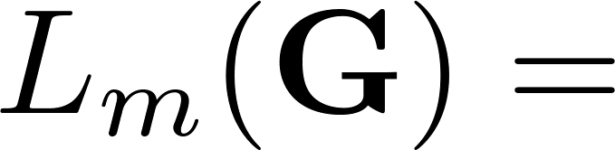


Examples

Slide 24

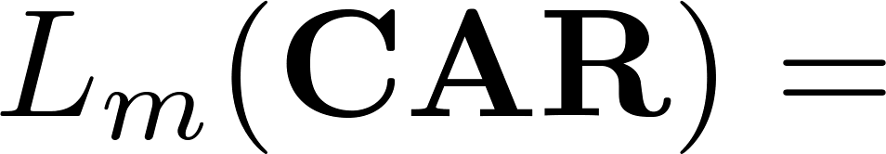
A car
States:
Parked: 0
15
0
4
Running: 1
Broken: 2
10
11
13
Junk: 3
Missing: 4
1
2
3
12
14

Slide 25
Closed and marked behaviors

Slide 26




“Bad” strings

Slide 27
Nonblocking characterization

