Slide 1
Supervisory Control under Partial Observation (continued)

Slide 2


Centralized architecture under partial observation
Observation
Channel

Slide 3
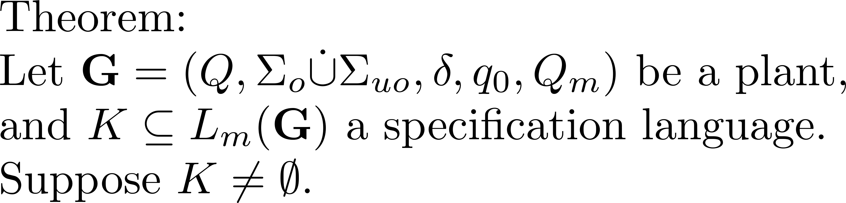
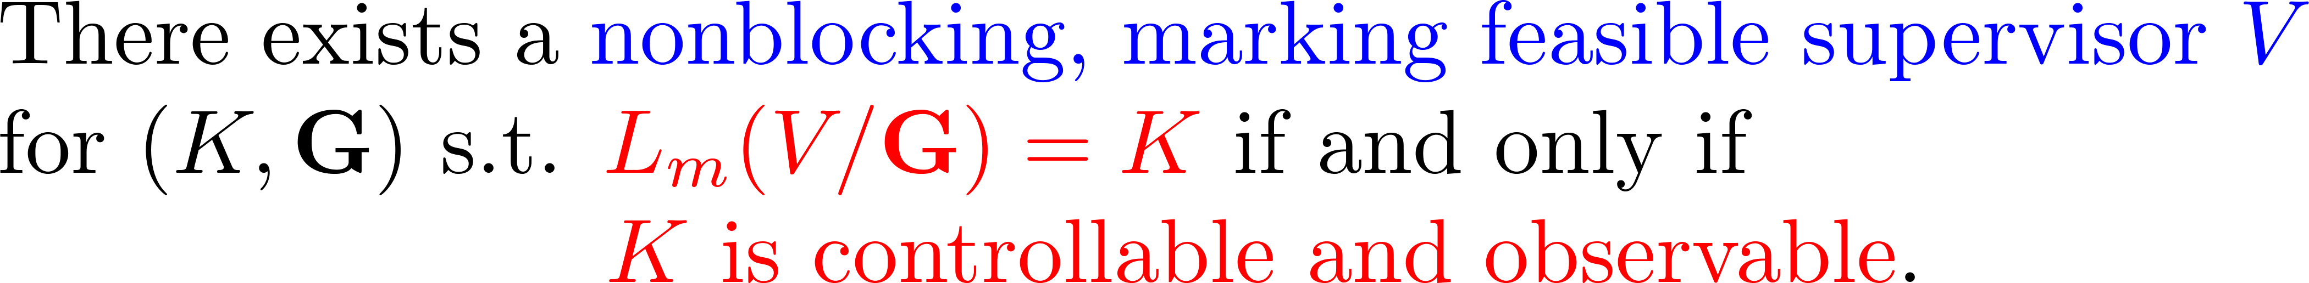
Main result

Slide 4








Example
1
2
3
1
2
3
0
4
5
0
4
5
6
7
8
6
7
1
2
3
0
4
5
0
4
5
6
7

Slide 5
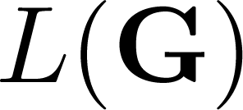



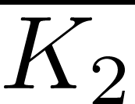

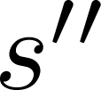

Observability not closed under union

Slide 6
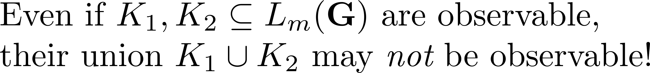
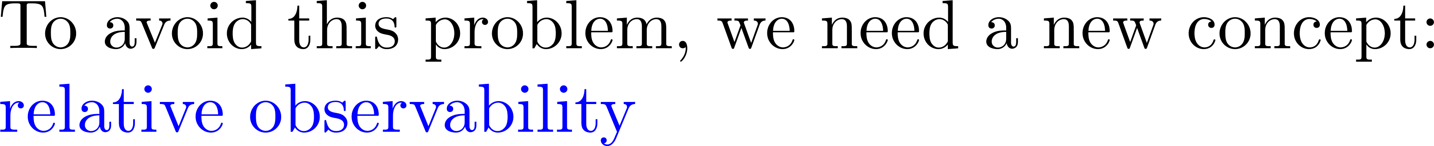
Problem with observability

Slide 7
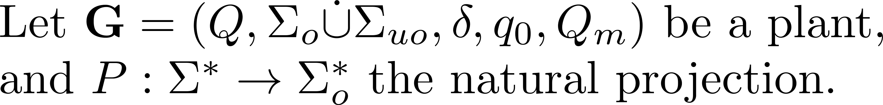
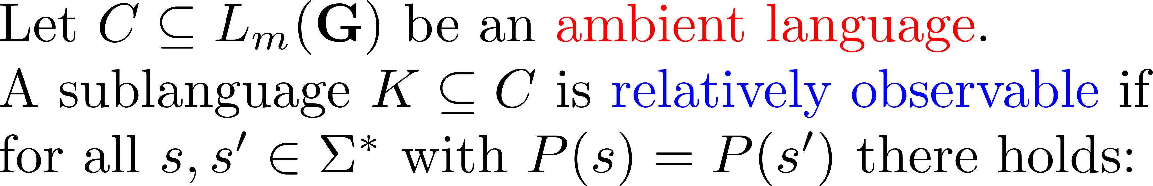
Relative observability

Slide 8



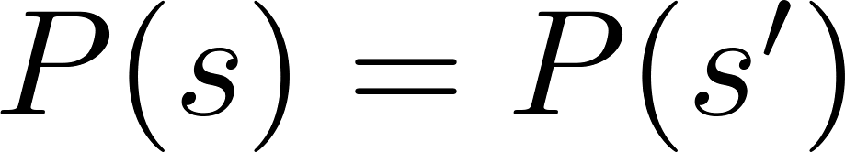
Relative observability

Slide 9

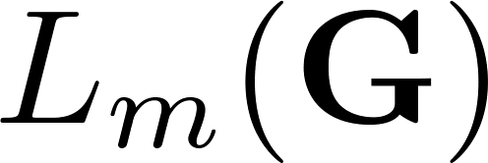
Relative observability

Slide 10
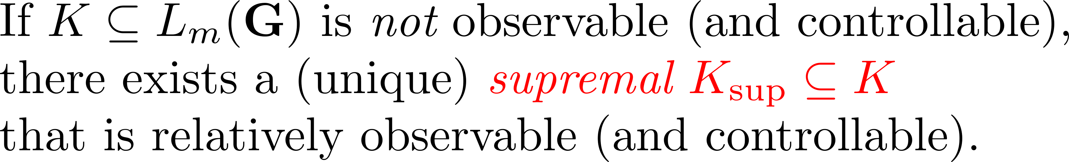
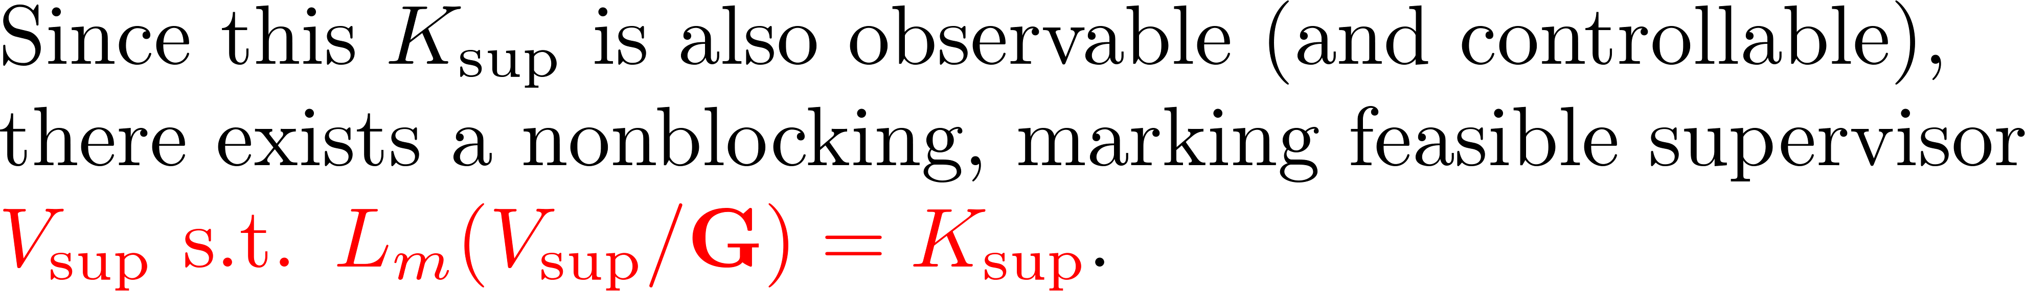
Properties of relative observability

Slide 11
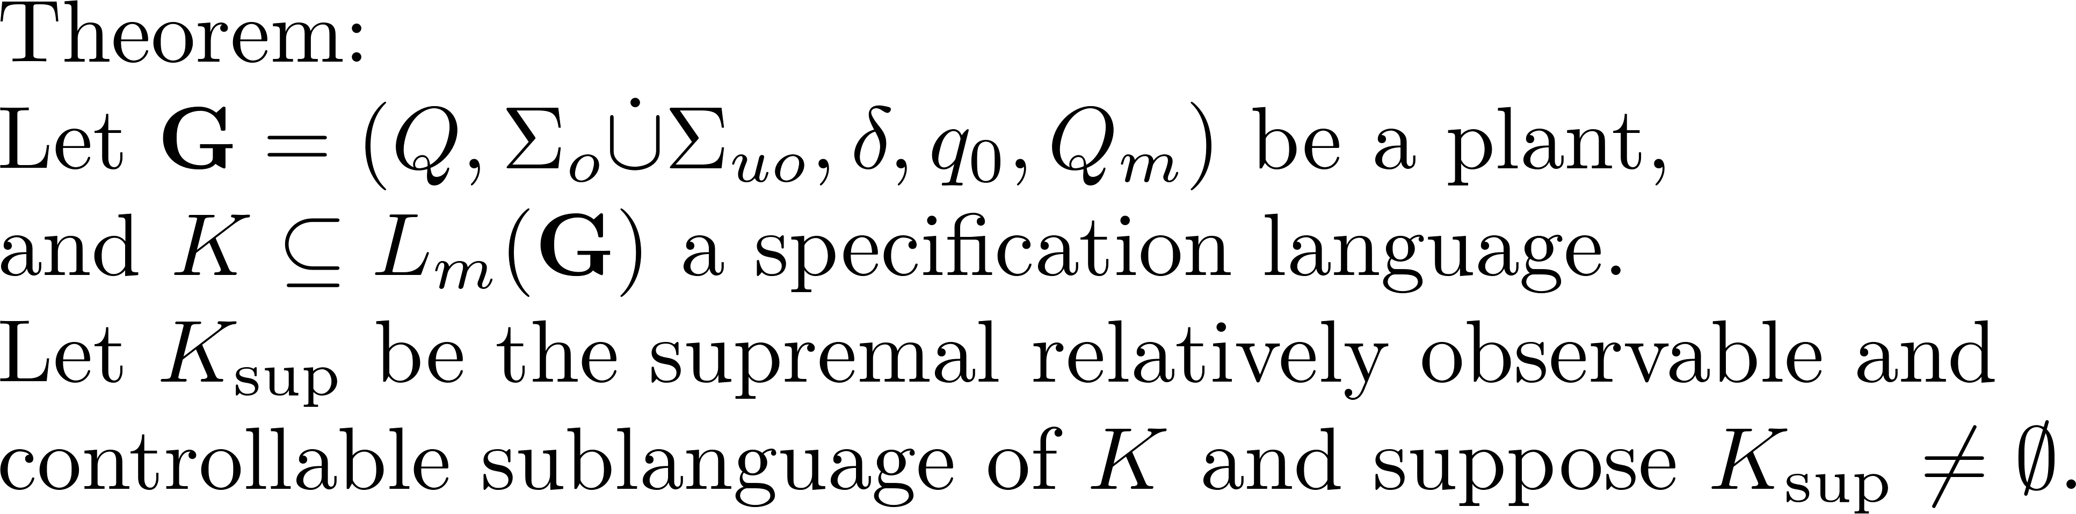
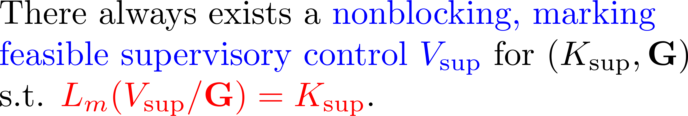
Partial-observation supervisory control: optimality

Slide 12
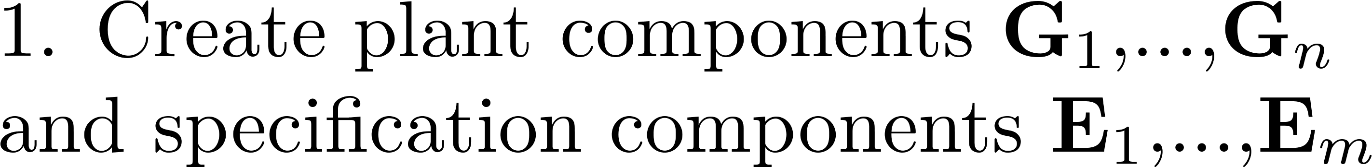
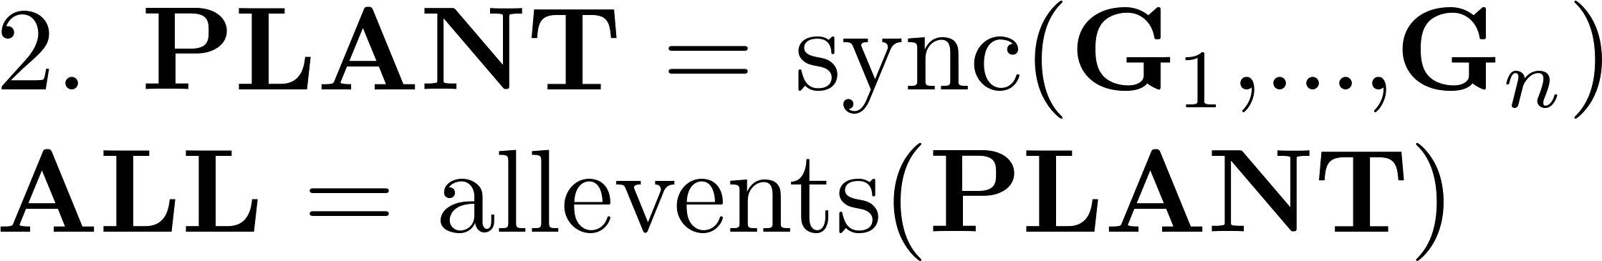
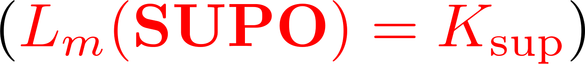
Partial-observation supervisor by MatlabTCT
supconrobs('SUPO', 'PLANT', 'SPEC', [10,20]);

Slide 13
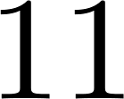






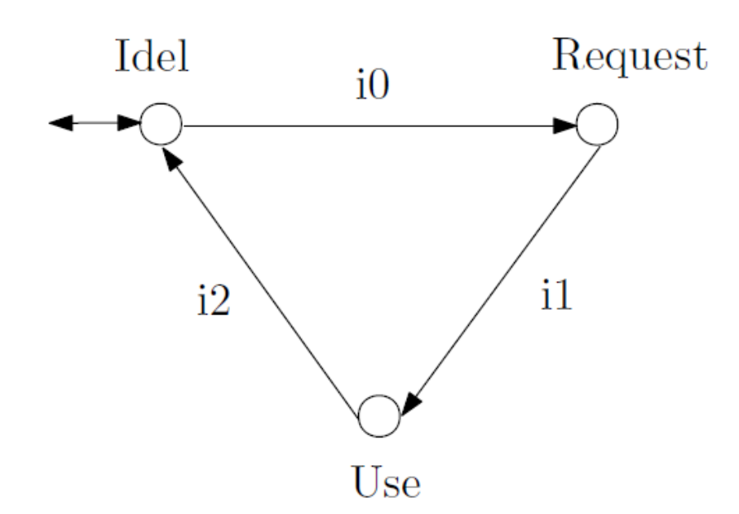
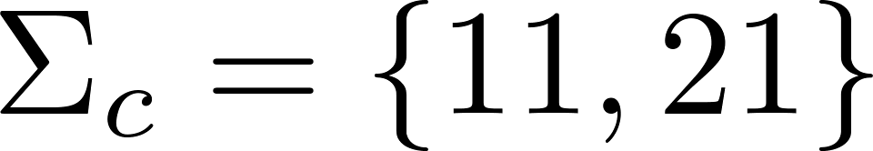
Resource allocation

Slide 14
Resource allocation
21
11
2
0
1
22
12

Slide 15
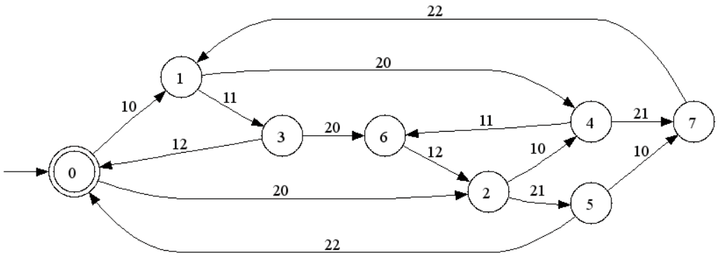
Resource allocation
11
21

Slide 16
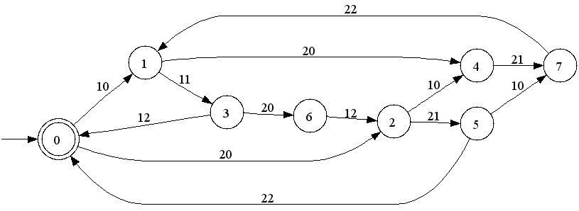
Resource allocation
11
11
21

Slide 17
Resource allocation

Slide 18





Guideway
1
2
3
4
Sta. A
Sta. B
Red
train
11
13
10
15
12
5
0
1
2
3
4
Green
train
21
23
20
25
22
5
0
1
2
3
4

Slide 19
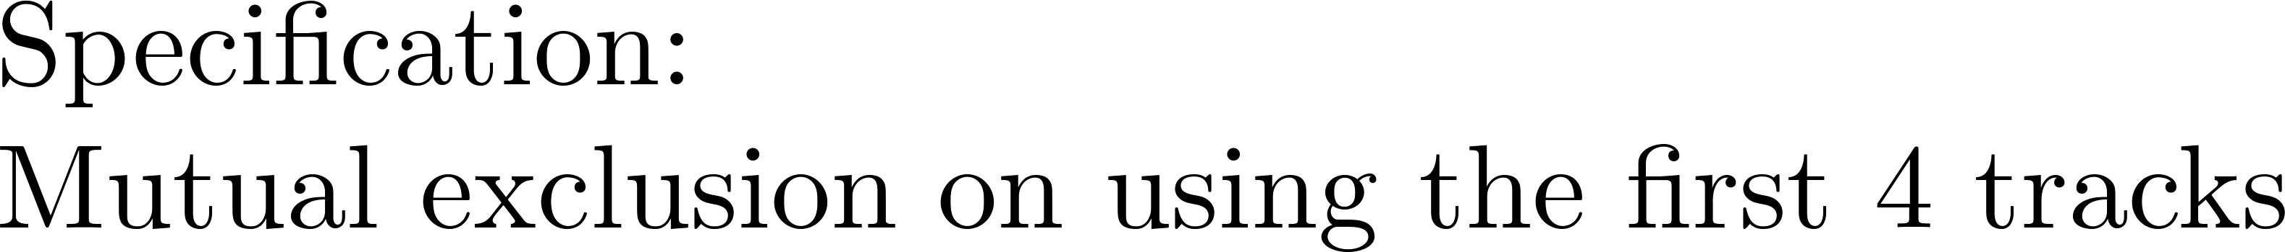
Guideway
1
2
3
4
Sta. A
Sta. B

Slide 20
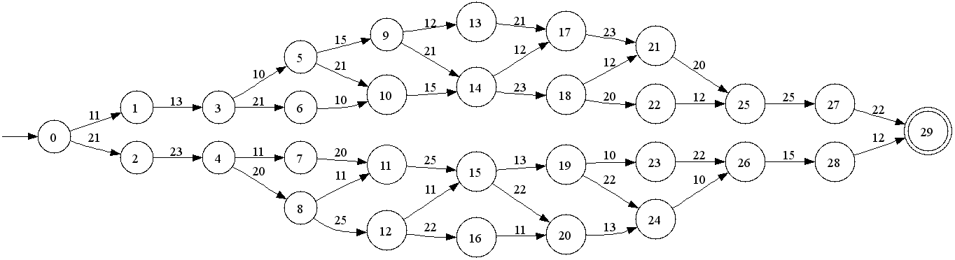
Guideway
1
2
3
4
Sta. A
Sta. B
21
23
25
23
11
13
15
13

Slide 21
Guideway
1
2
3
4
Sta. A
Sta. B
Red
train
11
13
10
15
12
5
0
1
2
3
4
Green
train
21
23
20
25
22
5
0
1
2
3
4

Slide 22
Guideway
1
2
3
4
Sta. A
Sta. B
21
23
25
23
10
20
20
10
10
20
11
13
15
13

Slide 23
Guideway
1
2
3
4
Sta. A
Sta. B
Red
train
11
13
10
15
12
5
0
1
2
3
4
Green
train
21
23
20
25
22
5
0
1
2
3
4

Slide 24
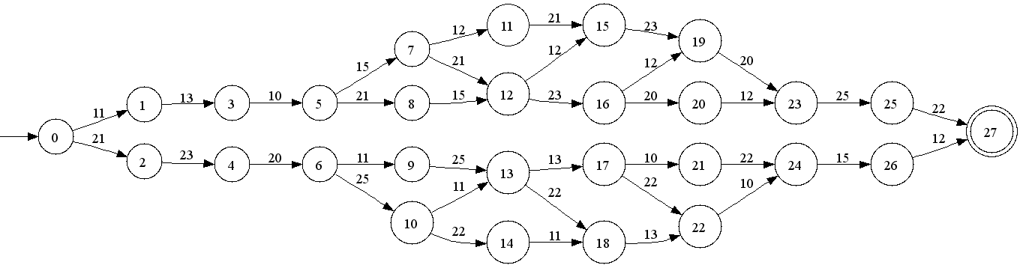
Guideway
1
2
3
4
Sta. A
Sta. B
21
21
23
23
25
13
23
11
11
13
13
15

Slide 25
Guideway
1
2
3
4
Sta. A
Sta. B
Red
train
11
13
10
15
12
5
0
1
2
3
4
Green
train
21
23
20
25
22
5
0
1
2
3
4

Slide 26
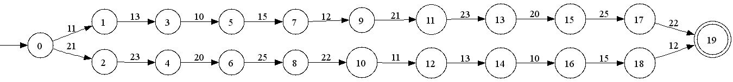
Guideway
1
2
3
4
Sta. A
Sta. B
21
21
21
21
13
10
15
23
20
25
23
20
25
13
10
15
11
11
11
11

Slide 27
Guideway
1
2
3
4
Sta. A
Sta. B
Red
train
11
13
10
15
12
5
0
1
2
3
4
Green
train
21
23
20
25
22
5
0
1
2
3
4

Slide 28
Guideway
1
2
3
4
Sta. A
Sta. B

Slide 29
Summary of the course
  DES modeling: automata and languages
  Supervisory control theory: centralized
  Decentralized control and coordination
  Distributed control by supervisor localization
  Supervisory control under partial observation

