Slide 1
Supervisory Control under Partial Observation

Slide 2


Centralized architecture with full observation

Slide 3
Centralized architecture under partial observation
Observation
Channel

Slide 4
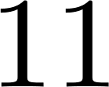
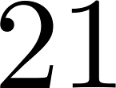



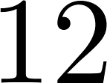
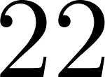
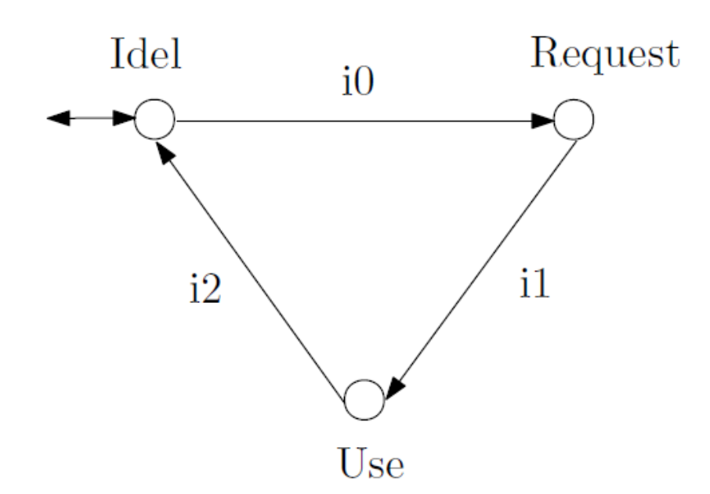

Example: resource allocation

Slide 5

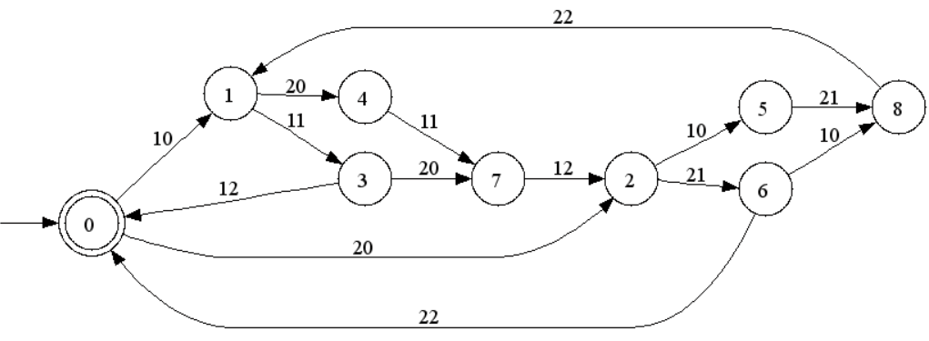
Resource allocation
21
11
11
21

Slide 6
Resource allocation
21?
11?
11?
21?

Slide 7
Plant G

Slide 8

Centralized architecture under partial observation
Observation
Channel

Slide 9




Natural projection

Slide 10



Natural projection

Slide 11


Natural projection

Slide 12


Natural projection

Slide 13

Centralized architecture under partial observation
Observation
Channel

Slide 14


Feasible supervisor

Slide 15
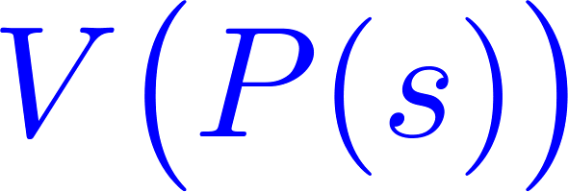
Centralized architecture under partial observation
Observation
Channel

Slide 16






Closed behavior of

Slide 17
Marked behavior of

Slide 18




Nonblocking

Slide 19


Main question

Slide 20

The answer

Slide 21


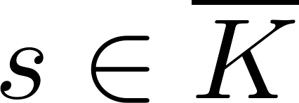

Controllability

Slide 22


Observability

Slide 23


Observability

Slide 24





Example
1
2
3
1
2
3
0
0
4
5
6
4
5

Slide 25
Example
1
2
3
1
2
0
0
4
5
6
4
5

Slide 26

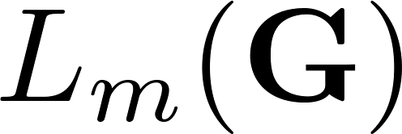
Observability

Slide 27
Example
1
2
3
1
2
3
0
0
4
5
6
4
5
6

Slide 28
Example
1
2
3
1
2
3
0
0
4
5
6
4
5
6

Slide 29

Observability

Slide 30


Main result

