Slide 1
Distributed Supervisory Control
(continued)

Slide 2
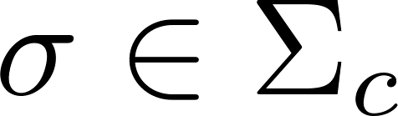

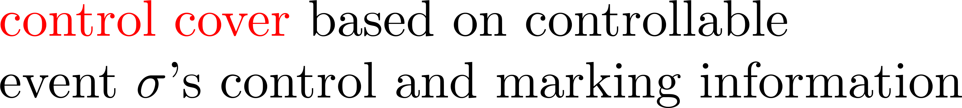


Slide 3




Example
1
0
2
0,1
2
3
3
control cover

Slide 4
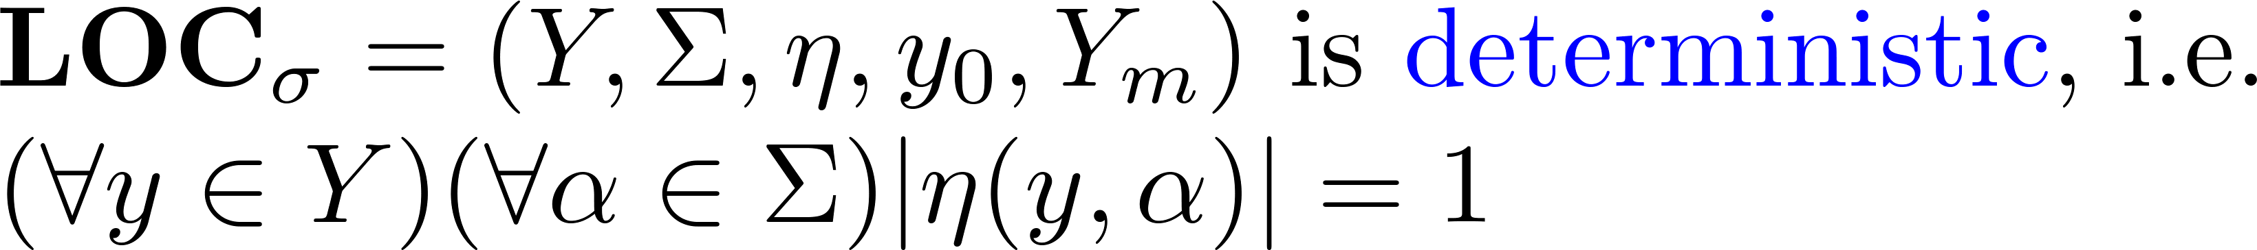
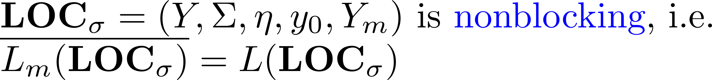
Note

Slide 5
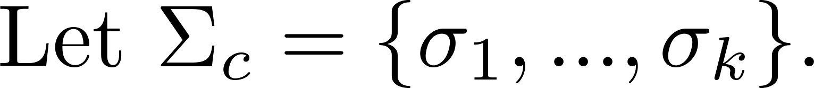

Localization result

Slide 6
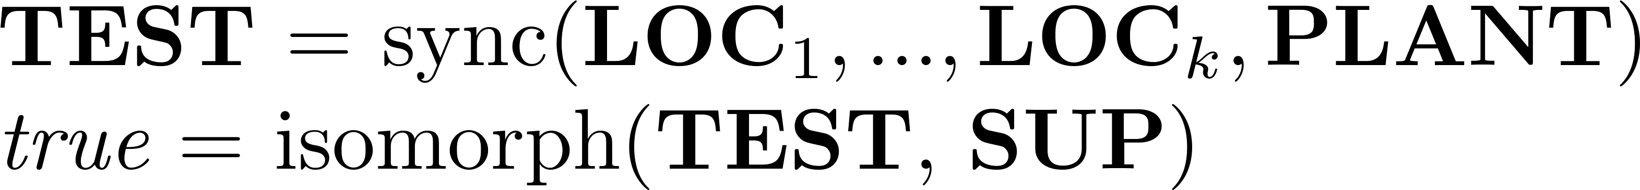
Localization in MatlabTCT
%Supervisor localization for transfer line
agent = {'M1', 'M2', 'TU'};
loc = {'LOC1', 'LOC3', 'LOC5'};
localize(loc, 'PLANT', 'SUP', agent);

Slide 7
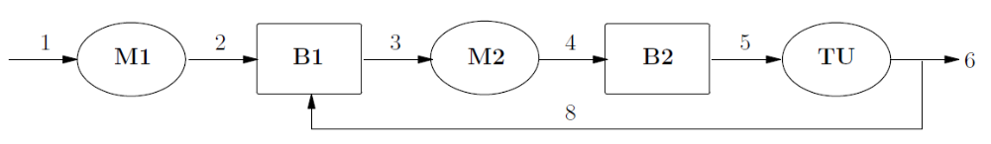
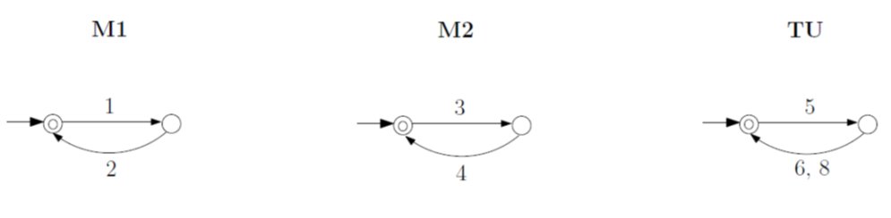
Transfer Line

Slide 8
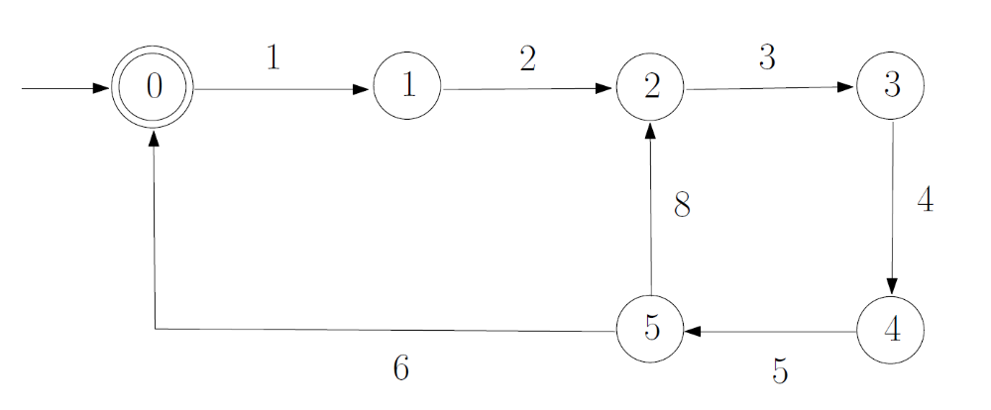
Transfer Line
3,5
3,5
1,5
1,5
1,3
1,3

Slide 9
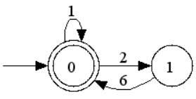

Control actions of event 1 (M1)
1
1
1
1

Slide 10
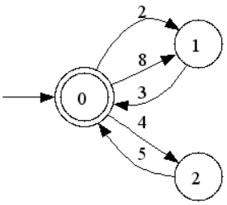
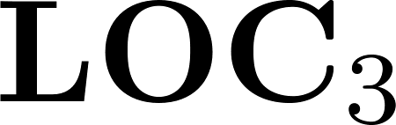
Control actions of event 3 (M2)
3
3
3
3

Slide 11

Control actions of event 5 (TU)
5
5
5
5

Slide 12
Transfer Line
5
1
3
5
3
Agent M1
Agent M2
Agent TU

Slide 13
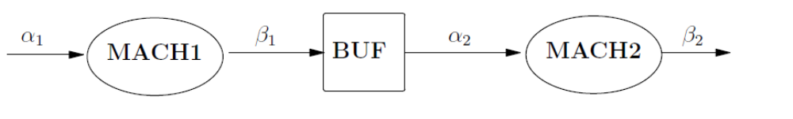


Small Factory
2-slot
11
10
21
20
0
0
11
10
21
20
1
1

Slide 14
Small Factory
2-slot
11
10
21
20
11
0,0
21
10
20
1,0
0,1
20
10
21
1,1
11

Slide 15


Small Factory
2-slot
11
10
21
20
10
10
0
1
2
21
21

Slide 16

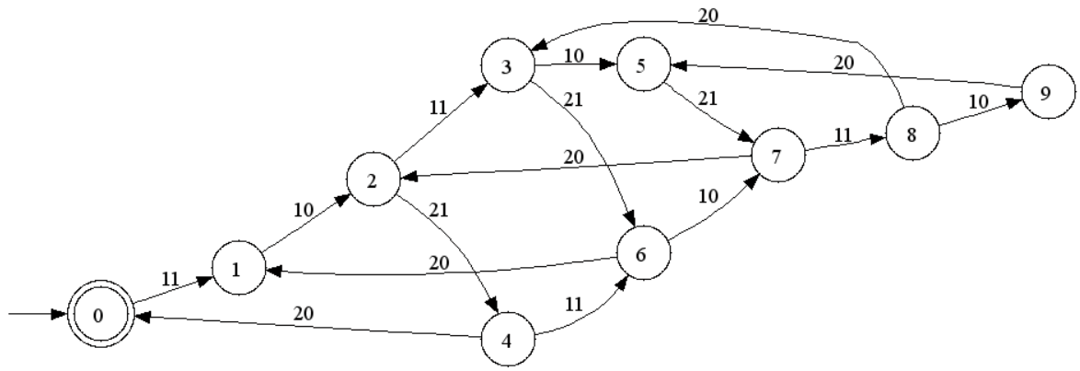
Small Factory
2-slot
11
10
21
20
11
11
21
21

Slide 17
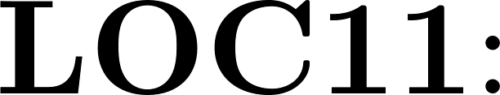
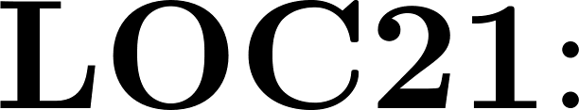
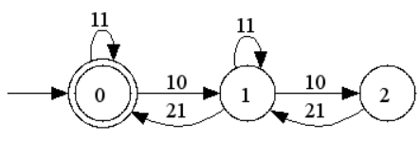
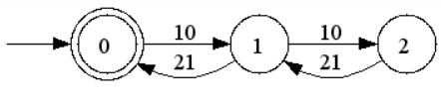
Small Factory
2-slot
11
10
21
20
11
21

Slide 18
Small Factory
11
21
Agent M1
Agent M2

Slide 19
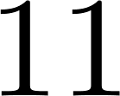
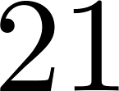




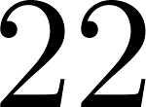

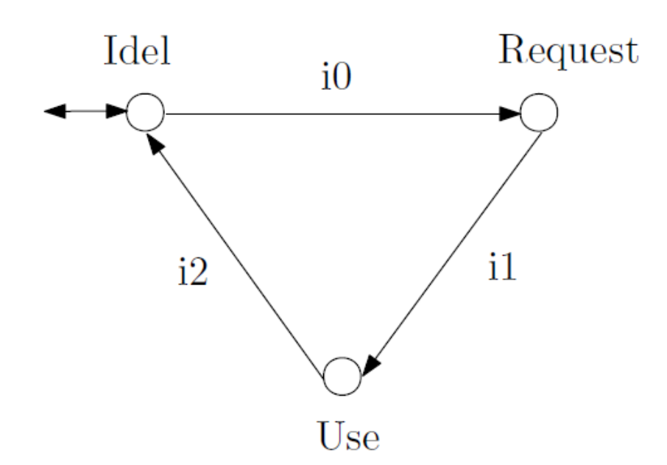
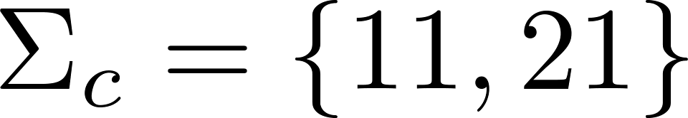
Resource allocation

Slide 20
Resource allocation
21
11
2
0
1
22
12

Slide 21
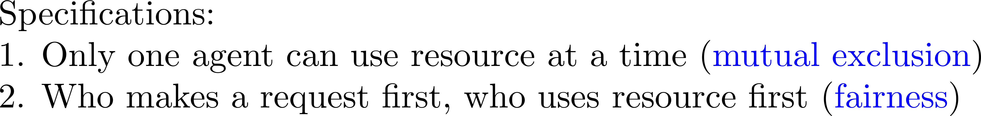
Resource allocation
20
1
3
11
10
11
0
20
21
21
2
4
10

Slide 22

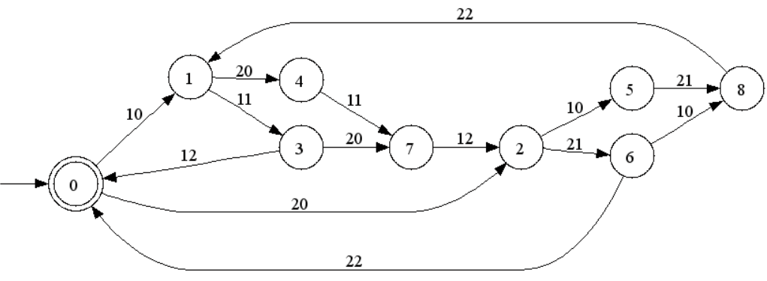
Resource allocation
21
11
11
21

Slide 23
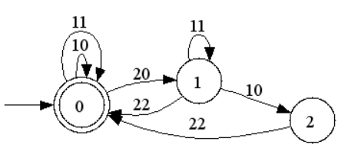
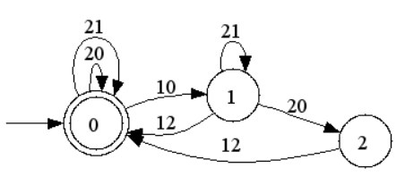
Resource allocation
11
21

Slide 24
Resource allocation
11
21
Agent A1
Agent A2

Slide 25
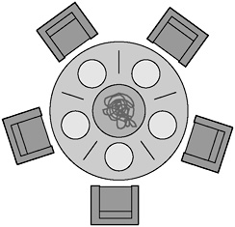
Dining philosophers
(Dijkstra, 1965)
thinking
thinking
thinking
thinking
thinking

Slide 26
Dining philosophers
(Dijkstra, 1965)
thinking
thinking
thinking
thinking
thinking

Slide 27
Dining philosophers
(Dijkstra, 1965)
thinking
thinking
thinking
thinking
thinking

Slide 28
Dining philosophers
(Dijkstra, 1965)
thinking
thinking
eating
thinking
thinking
thinking

Slide 29
Dining philosophers
(Dijkstra, 1965)
thinking
thinking
eating
thinking
thinking
thinking

Slide 30
Dining philosophers
(Dijkstra, 1965)
thinking
thinking
eating
thinking
thinking
thinking

Slide 31
Dining philosophers
(Dijkstra, 1965)
thinking
thinking
eating
thinking
thinking
thinking
eating

Slide 32
Dining philosophers
(Dijkstra, 1965)
thinking
thinking
eating
thinking
thinking
thinking
eating

Slide 33
Dining philosophers
(Dijkstra, 1965)
thinking
thinking
eating
thinking
thinking
eating
thinking
eating

Slide 34
Dining philosophers
(Dijkstra, 1965)
thinking
thinking
eating
thinking
thinking
eating
thinking
eating

Slide 35
Dining philosophers
(Dijkstra, 1965)
thinking
thinking
thinking
thinking
thinking

Slide 36
Dining philosophers
(Dijkstra, 1965)
thinking
thinking
thinking
thinking
thinking

Slide 37
Dining philosophers
(Dijkstra, 1965)
thinking
thinking
thinking
thinking
thinking

Slide 38
Dining philosophers
(Dijkstra, 1965)
thinking
thinking
thinking
thinking
thinking

Slide 39
Dining philosophers
(Dijkstra, 1965)
thinking
thinking
thinking
thinking
thinking

Slide 40
Dining philosophers
(Dijkstra, 1965)
thinking
thinking
thinking
thinking
deadlock!
thinking

Slide 41
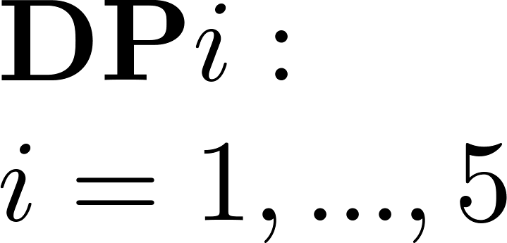
Dining philosophers
(Dijkstra, 1965)
0
wake
return
left
right
2
1
4
right
3
left
Controllable events: left, right
Uncontrollable events: wake, return

Slide 42
Dining philosophers
(Dijkstra, 1965)
0
wake
return
left
right
2
1
4
right
3
left

Slide 43
Dining philosophers
(Dijkstra, 1965)
1
Specification 1:
‘mutual exclusion’
1_left
2_right
2
For example:
1
0
2
1_return
2_return

Slide 44
Dining philosophers
(Dijkstra, 1965)
1
Specification 1:
‘mutual exclusion’
Specification 2: ‘fairness’
1_left
2_right
2
For example:
1
0
2
1_return
2_return
2_wake
1_return
1
3
1_wake
1_return
For example:
0
FIFO queue
2_wake
2_return
2_return
2
4
1_wake

Slide 45
Dining philosophers
(Dijkstra, 1965)
Monolithic supervisor SUP
has 3061 states
SUP

Slide 46
Dining philosophers
(Dijkstra, 1965)
Monolithic supervisor SUP
has 3061 states
Localization: 10 local controllers
  Each philosopher gets 2 local controllers

Slide 47

Dining philosophers
(Dijkstra, 1965)
LOC1_
right
5
DP1
0
LOC1_
left
1_wake
1_return
1_left
2
1_right
2
1
4
1_right
3
1_left

Slide 48
Dining philosophers
(Dijkstra, 1965)
LOC1_
right
5
DP1
0
LOC1_
left
1_wake
1_return
1_left
2
1_right
2
1
4
1_right
3
1_left
1_wake
LOC1_left
1_left
1_left
2_return
0
2_wake
1
2_return
1_wake
2
1_left

Slide 49
Dining philosophers
(Dijkstra, 1965)
LOC1_
right
5
DP1
0
LOC1_
left
1_wake
1_return
1_left
2
1_right
2
1
4
1_right
3
1_left
1_wake
LOC1_left
1_wake
LOC1_right
1_left
1_left
1_right
1_right
2_return
5_return
0
2_wake
1
0
5_wake
1
2_return
1_wake
5_return
1_wake
2
1_left
2
1_right

Slide 50
Dining philosophers
(Dijkstra, 1965)
LOC5_right
LOC1_right
LOC5_left
LOC1_left
DP5
DP1
LOC4_right
LOC2_right
DP4
LOC4_left
DP2
LOC2_left
DP3
LOC3_right
LOC3_left

Slide 51
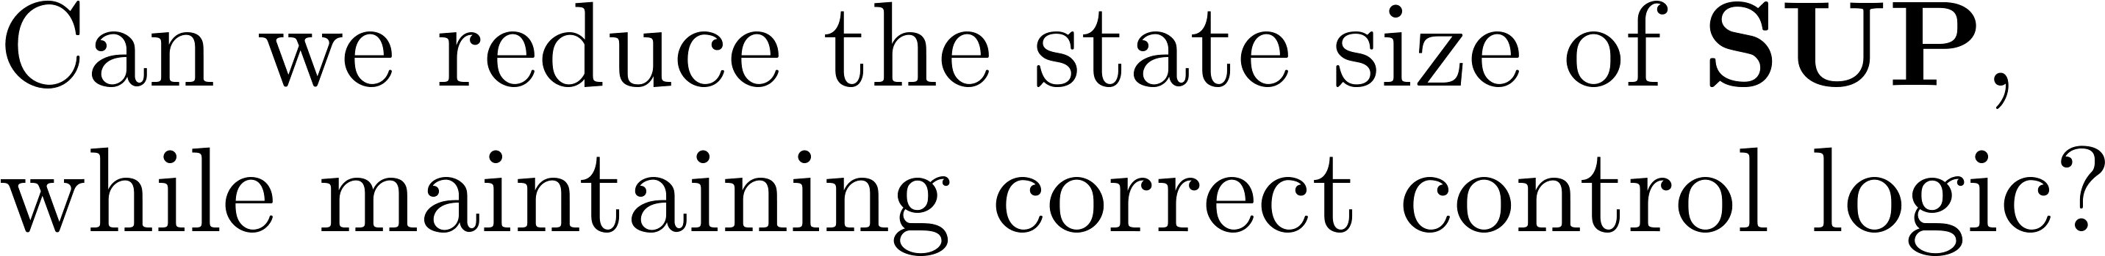
Supervisor reduction

Slide 52




