Slide 1
Distributed Supervisory Control

Slide 2







Review
1
3
5
1
3
5

Slide 3
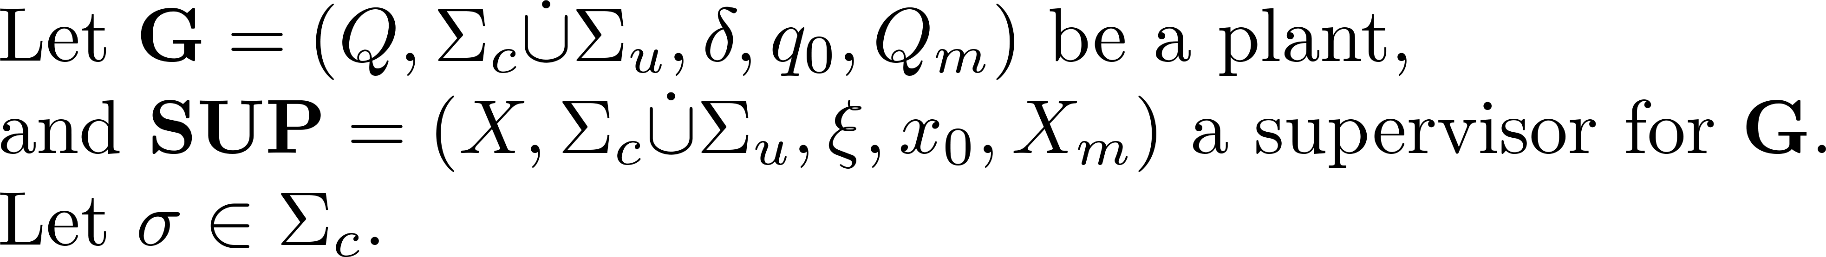
Control consistency relation

Slide 4
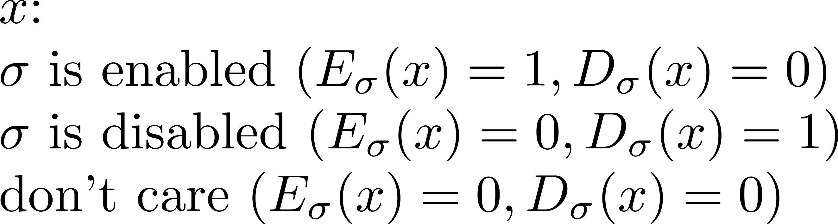
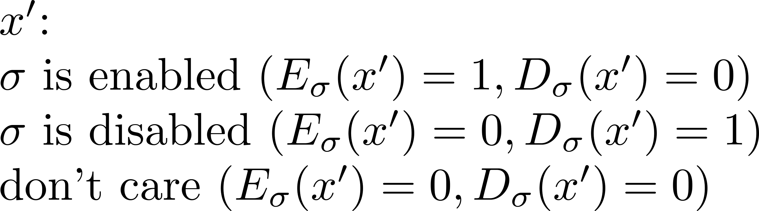
Control consistency relation

Slide 5






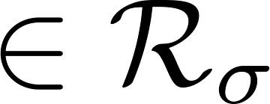
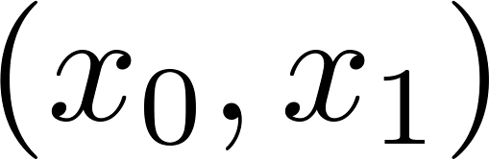
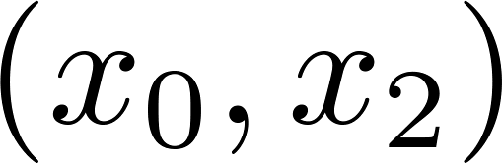
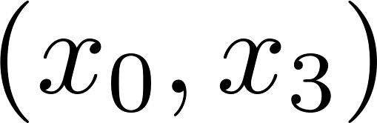
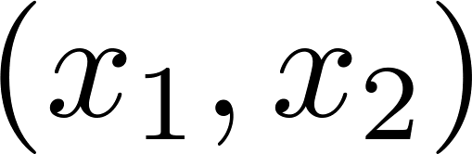
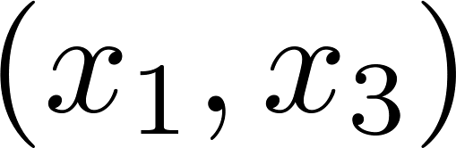
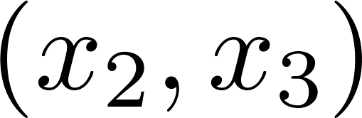
Example
1
1
0
2
0
2
3
3

Slide 6

Control consistency relation

Slide 7
Example
1
1
0
2
0
2
3
3

Slide 8
Equivalence relation

Slide 9
Tolerance relation

Slide 10
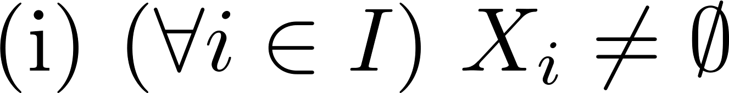


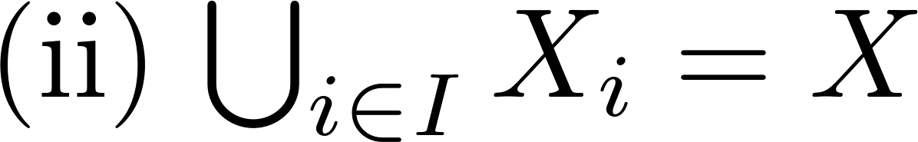


Partition (cf. equivalence relation)

Slide 11


Cover (cf. tolerance relation)

Slide 12
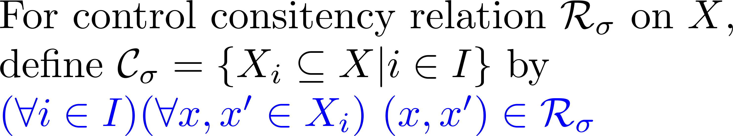
Cover

Slide 13
Example
1
0
2
0,1
1,2,3
3
nondeterministic !

Slide 14






Control cover

Slide 15
Example
1
0
2
0,1
1,2,3
3
nondeterministic !
Is this cover a control cover ?

Slide 16
Example
1
0
2
0,1
1,2
3
3
control cover !
deterministic !

Slide 17
Example
1
0
2
0,1
2
3
3
control congruence
deterministic !

Slide 18

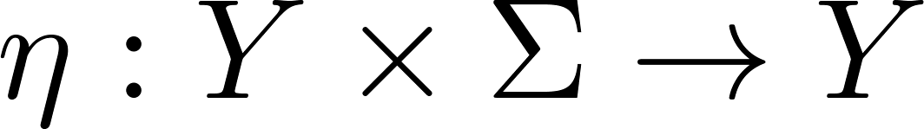
Local controller
1
0
2
3

