Slide 1
Alphabet, Strings, Languages

Slide 2

Alphabet

Slide 3
Strings

Slide 4
Strings

Slide 5
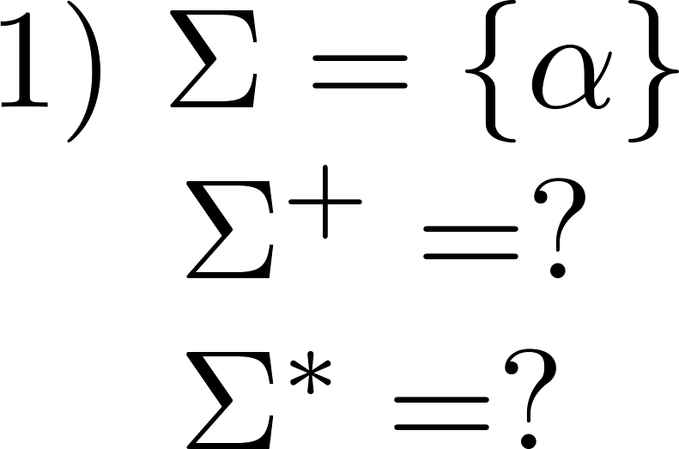
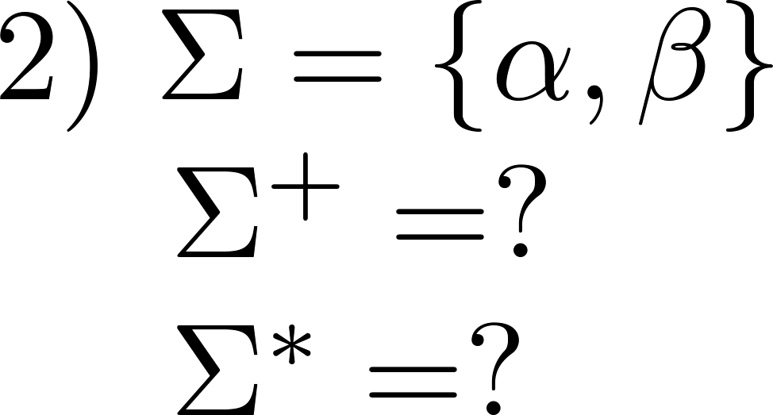
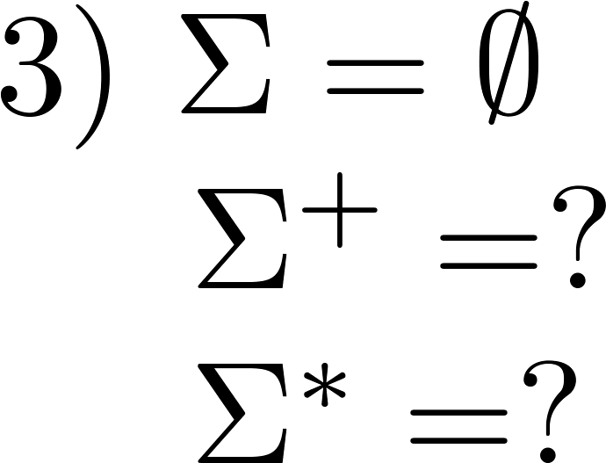
Examples

Slide 6
Catenation of strings
Catenation function

Slide 7


String length

Slide 8




String prefix

Slide 9


Examples

Slide 10


Languages
Language

Slide 11


Aside: powerset

Slide 12
Examples of languages

Slide 13


Examples of languages

Slide 14


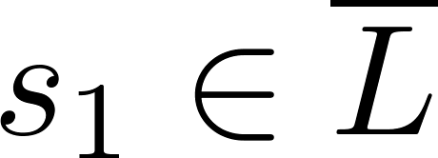

Language closure

Slide 15
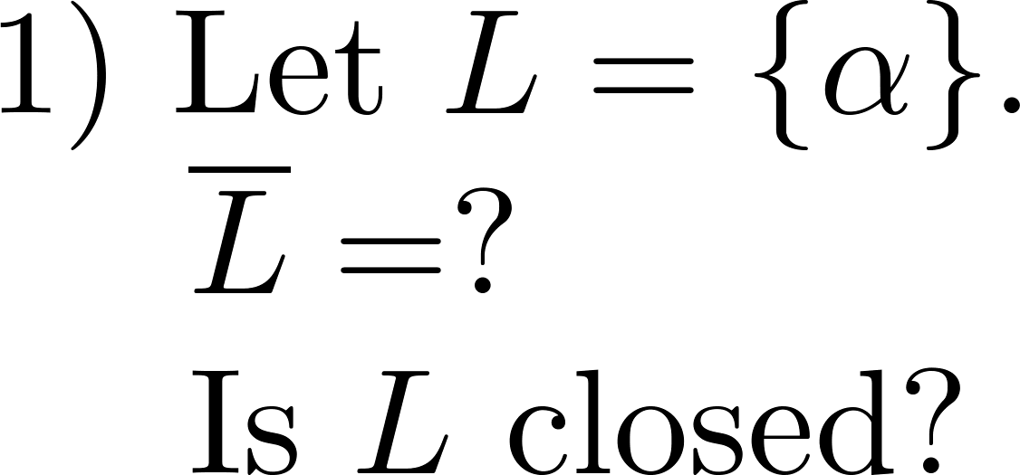

Examples

Slide 16
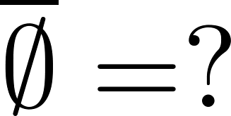



Examples

Slide 17

Aside: prove subset inclusion

