Slide 1
Control of Discrete-Event Systems
Instructor: Kai Cai
Period: 2021.04–07
(This course will be given in English)

Slide 2
Introduction

Slide 3
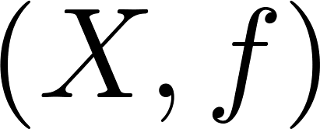
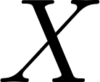

Dynamic systems
Dynamic = changing (opposed to static)
A dynamic system
  state set
  state transition function
Types of dynamics
  continuous(-time) dynamics
  discrete(-event) dynamics

Slide 4
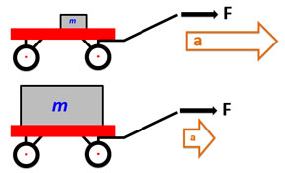
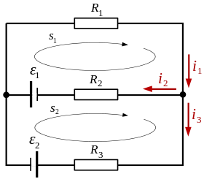

Continuous-time dynamic systems
Newton’s law
Ohm’s law, Kirchhoff's circuit law
Schrödinger's equation
states are real numbers,
state transitions are time-driven

Slide 5
Discrete-event dynamic systems
Discrete state set
  states have duration in time
Event-driven state transitions
  events are instantaneous
  Examples of events: push a button, switch on/off, train arrives/leaves, machine breaks down,…

Slide 6
Examples of discrete-event systems

Slide 7
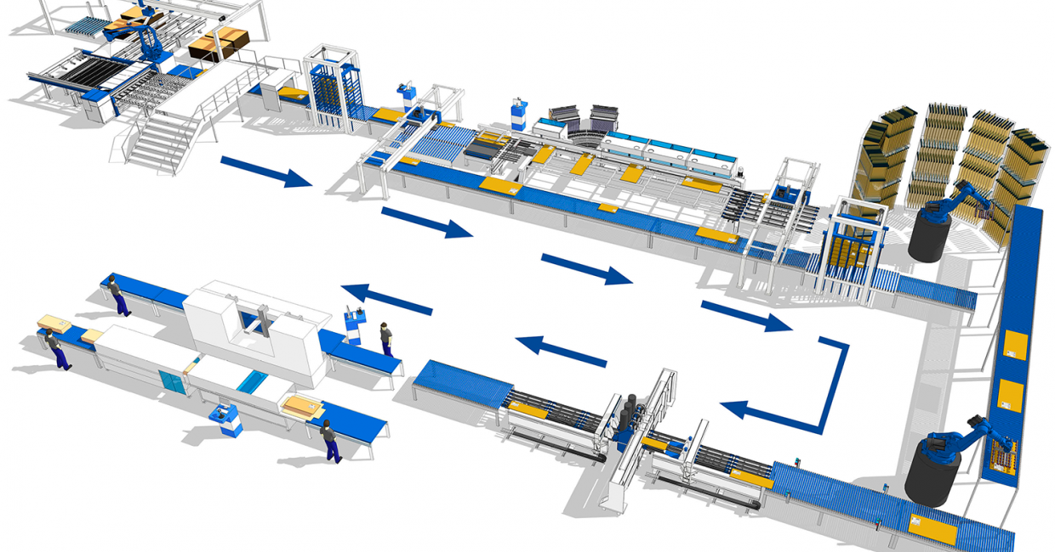
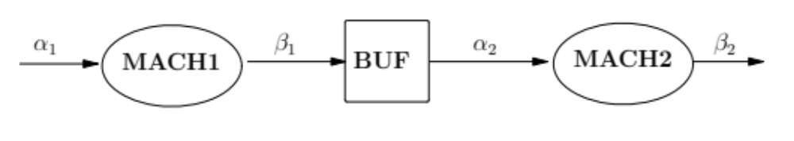
Manufacturing
Production cell: machines/robots, conveyor belts, buffers

Slide 8
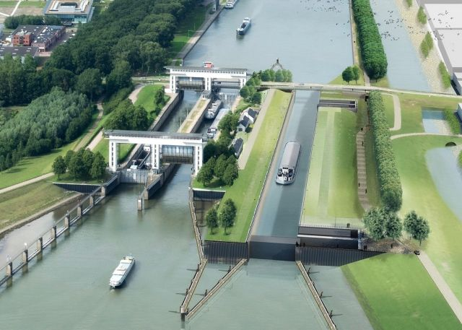
Infrastructure
Waterway lock system: ships, entering/existing canals

Slide 9
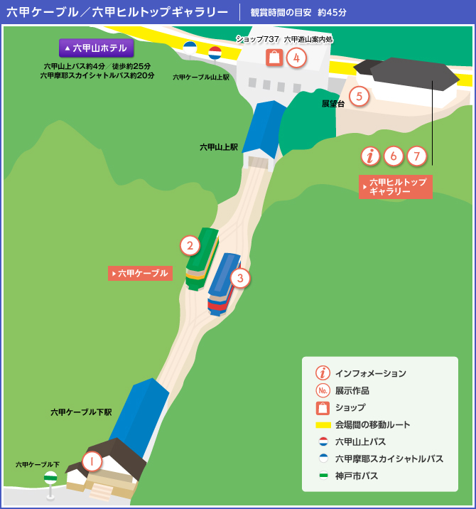
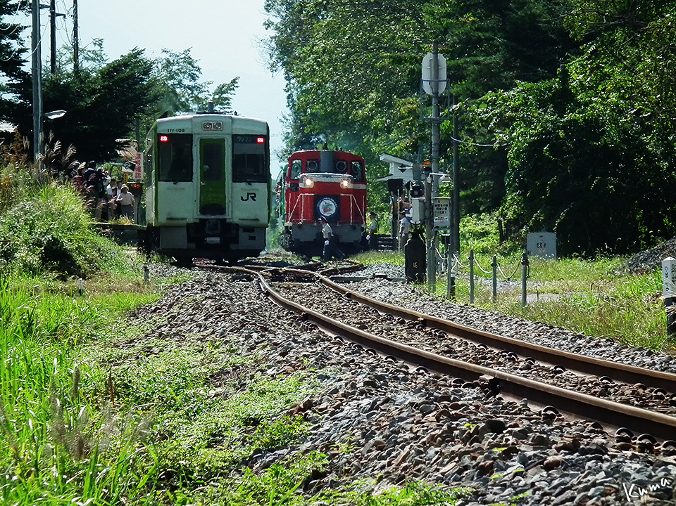
Transportation
Cable car system: two cars, one rail with one interchange

Slide 10
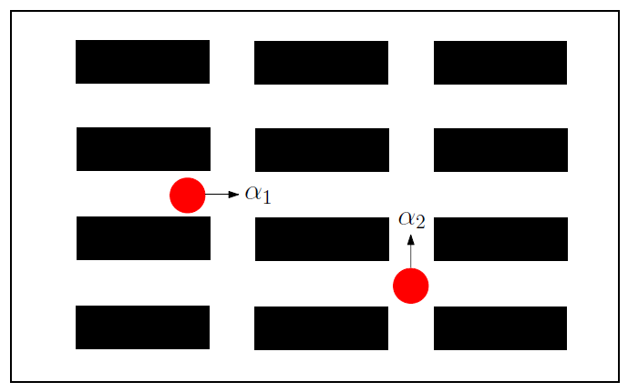
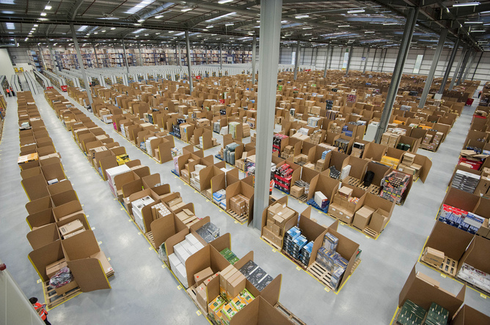
Logistics
Warehouse logistic management: robots are assigned to pick up products from shelves

Slide 11
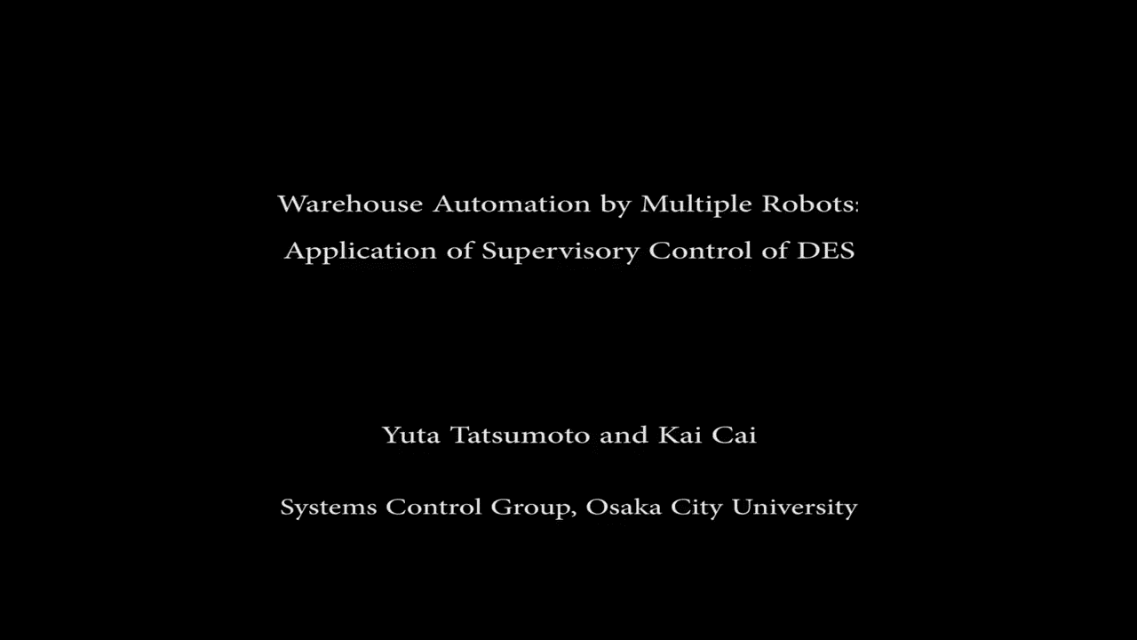
Logistics
by Yuta Tatsumoto

Slide 12
Other examples of discrete-event systems
Traffic networks
Communication protocols
Database management systems
Operating systems
Medical devices (e.g. CT, MRI)

Slide 13
Main questions
  Can we have a simple yet effective model for DES?

Slide 14
Main questions
  Can we have a simple yet effective model for DES?
  Can we systematically design controllers that satisfy the specifications imposed on a DES plant?

Slide 15
Main questions
  Can we have a simple yet effective model for DES?
  Can we systematically design controllers that satisfy the specifications imposed on a DES plant?
    - plant: dynamic system to be controlled
    - specification: control requirements, desired behaviors
    - controller: a procedure to make plant behave as desired

Slide 16
In this course you will learn
  DES modeling: automata and languages
  Supervisory control theory: centralized
  Supervisor localization: distributed
  Decentralized and hierarchical control
  Control under partial observation

Slide 17
Course information
Website (slides and videos uploaded weekly):
https://www.control.eng.osaka-cu.ac.jp/teaching/des-course-2021
Grading:
Five (5) homework assignments, each 20 points;
submission through Webclass by deadlines
Q & A:
Basically through WebClass bulletin board (掲示板)

